Slide 1
ART AND INTERCULTURAL DIALOGUE
ERASMUS+ KA229 PROJECT
2020-1-PL01-KA229-081615_2

Slide 2
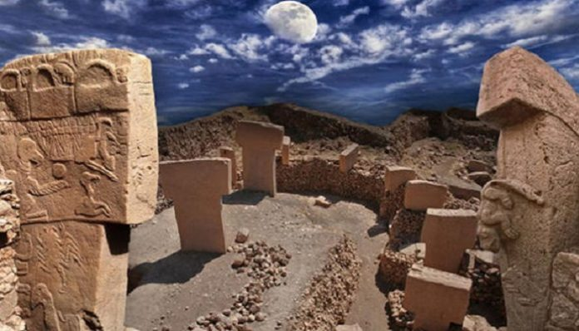
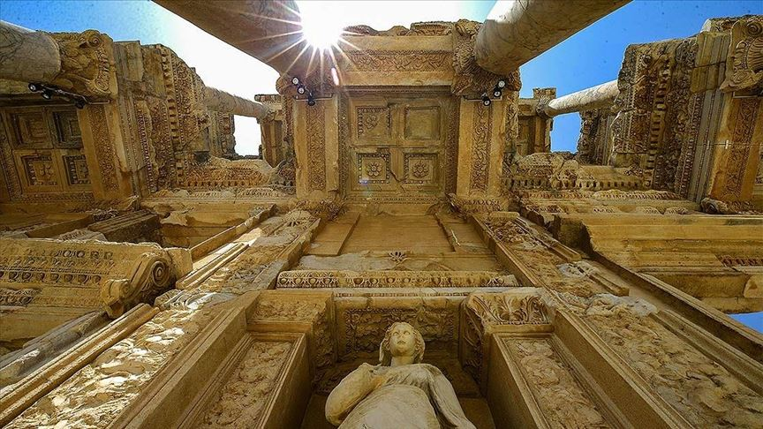
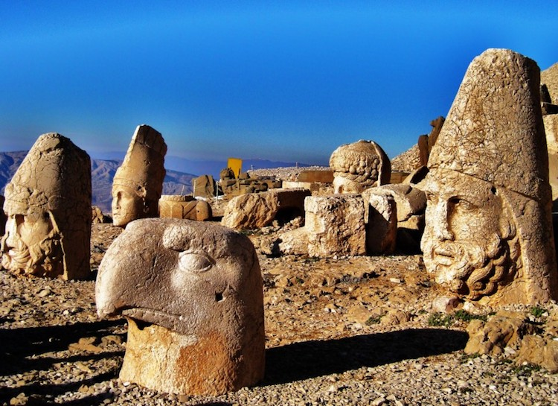
Turkey, the cradle of civilizations
Ephesus, which was included in the World Heritage Tentative List by UNESCO in 1994, was registered as a World Heritage Site in 2015. The city is famous for the nearby Temple of Artemis , one of the Seven Wonders of the Ancient World. Among many other monumental structures is the Library of Celsus and a theater that can hold 25,000 spectators. Ephesus was one of the seven churches of Asia mentioned in the Book of Revelation. The Gospel of John may have been written here
The tombs and monumental statues built on the slopes of Mount Nemrut, which is 2,150 meters high, by the Commagene King Antiochos I to show his gratitude to the gods and ancestors, are one of the most magnificent ruins of the Hellenistic Period
Göbeklitepe or Göbekli Tepe is the oldest known collection of cult structures in the world, located near Örencik village, 18 km northeast of Şanlıurfa city center. The monumental architecture unearthed during excavations makes Göbekli Tepe unique and special. In this context, it was included in the World Heritage tentative list by UNESCO in 2011 and entered the permanent list in 2018

Slide 3
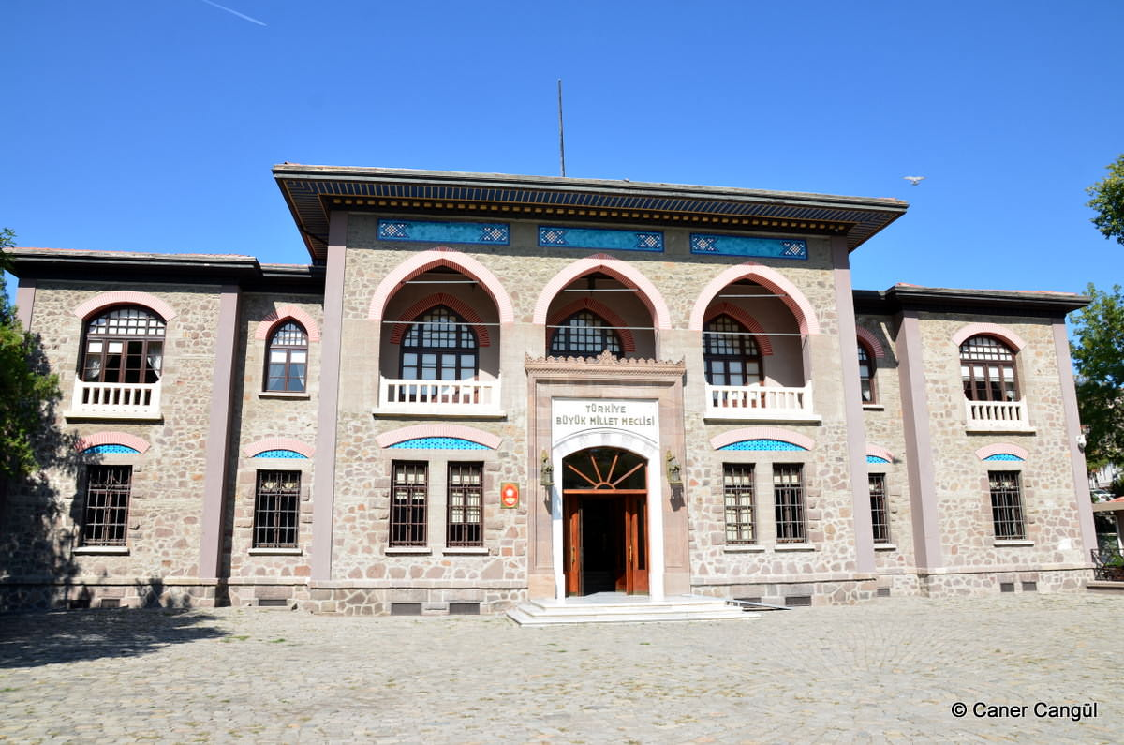
THE FIRST FOUNDATIONS OF THE REPUBLIC OF TURKEY
The building, where the activities of the Turkish Grand National Assembly were carried out between 1920 and 1924, was opened to the public on April 23, 1961 under the name of "Turkish Grand National Assembly Museum"
He is a Turkish soldier, statesman and the founder of the Republic of Turkey. Atatürk carried out secularist and nationalist reforms in political, economic and cultural fields in order to establish a modern, progressive and secular nation-state

Slide 4
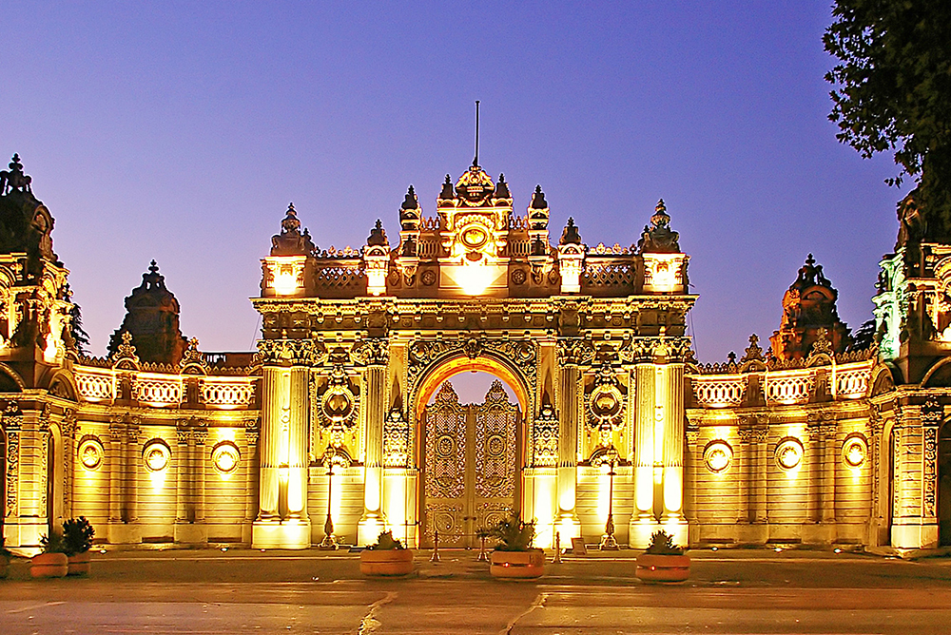
Architecture
From 1856 until the proclamation of the Republic, Dolmabahçe Palace witnessed every step of the Ottoman Empire opening to the west, and has witnessed many important reforms and revolutionary political moves since its establishment. The Language Revolution, which switched to the Latin alphabet, the opening of the Parliament, the History and Language congresses are some of these important political movements
Anıtkabir is a complex that includes the mausoleum of Mustafa Kemal Atatürk, located in the Çankaya district of Ankara, the capital city of Turkey. The construction of the building complex, designed by Emin Onat and Orhan Arda, started in 1944 and was completed in 1953.

Slide 5
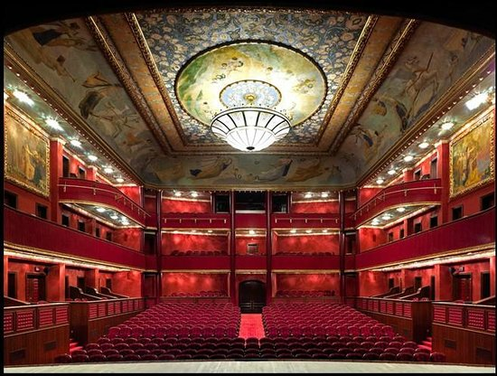
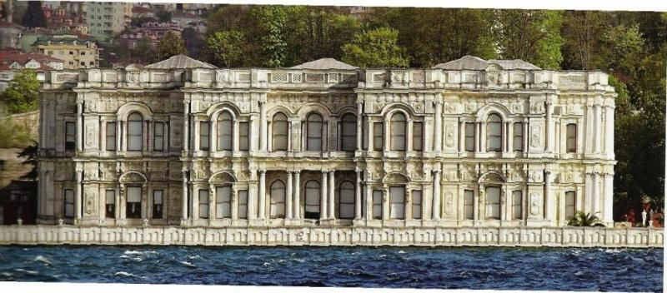
Architecture
Kadıköy's 80-year-old Süreyya Building, as Kadıköy Municipality Süreyya Opera, said "hello" to the art world on October 27, 2007. The historical building, designed by Süreyya İlmen Pasha as an opera house and built as an opera, theater and ballroom, is open to art lovers as the first Opera House of Kadıköy and the Anatolian Side, and the sixth of Turkey, after 2 years of meticulous restoration work by Kadıköy Municipality
It is a palace built between 1863-65, overlooking the vast blue of the Bosphorus. Beylerbeyi Palace, a 19th-century work that impresses with its set gardens and mansions, is a unique place where history and historical characters are guests

Slide 6
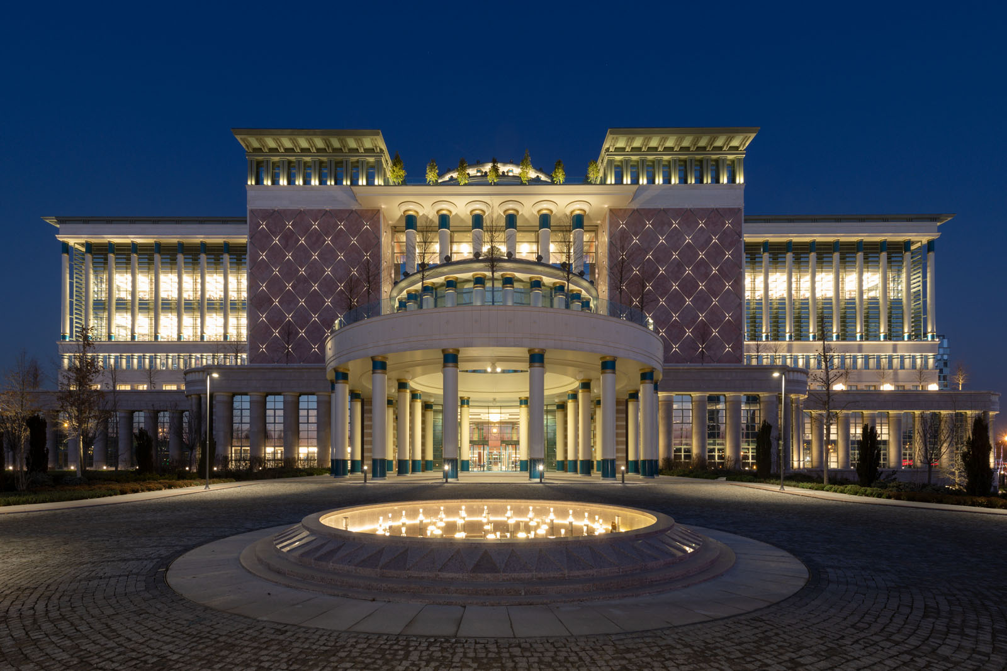
ARCHITECTURE-natıonal lıbrary
The library serves readers with a seating capacity of 5,500 on an area of ​​125,000 m².
There are 2,039,000 printed sources and 1,999,633 issues of 13,294 printed magazines in our collection. In addition, in the content of 67 databases accessed; 665.000 e-books, 7.000.000 electronic theses and 209.000.000 articles, reports, etc. of nearly 77,000 e-journals. are available. The presentation services of these information resources to the readers are provided with the understanding of modern librarianship. The National Library is the largest library in our country and aims to be among the few libraries in the world in terms of its collections and services

Slide 7
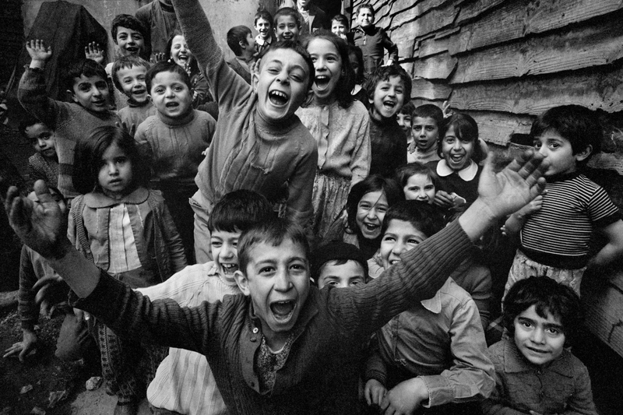
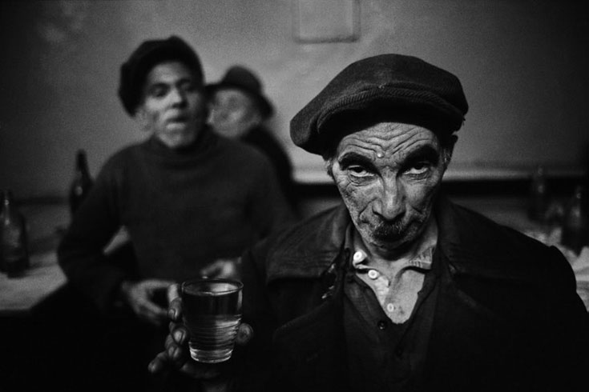
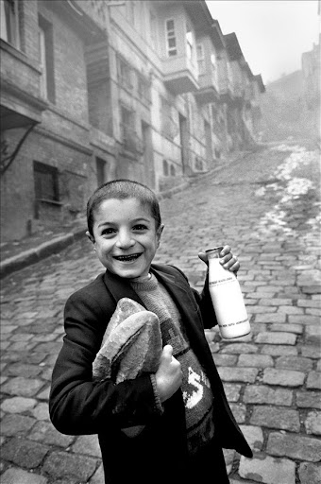
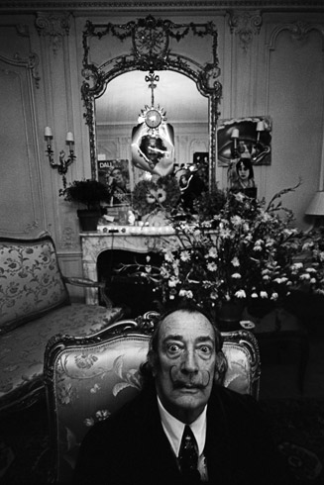
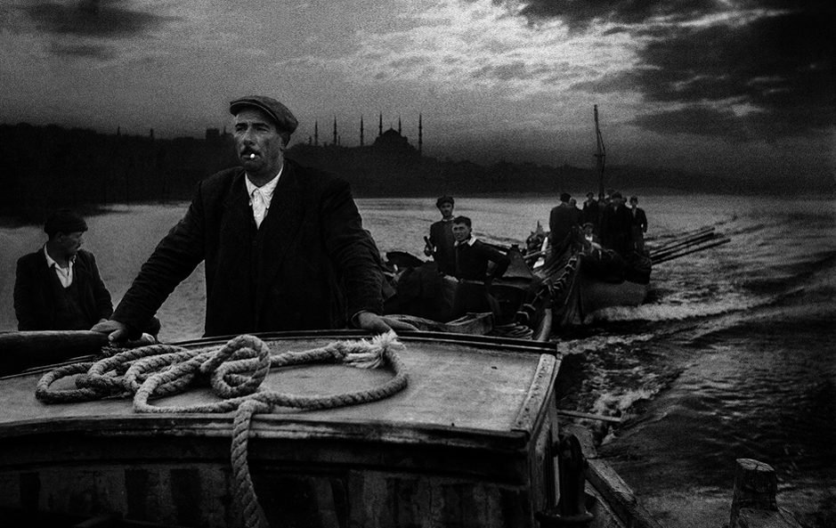
ART
Ara Güler is the most important representative of creative photography in Turkey, which has gained an international reputation. Turkish photographer and photojournalist of Armenian origin, who left behind his 60th year in art.

Slide 8
sculpture
The goddess Cybele is the goddess of fertility, as we mentioned above. Abundance and abundance are among the most important definitions in societies whose lives are based on agriculture. For this reason, Cybele appears as an important god figure. The concept of fertility we are talking about is represented by fertility, which is a woman-specific feature

Slide 9
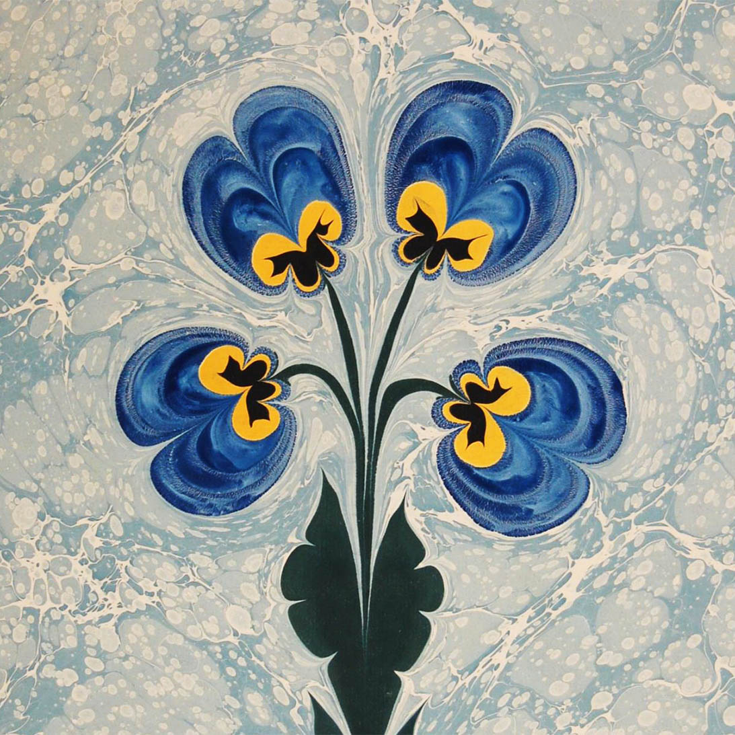
Marblıng art
The art of marbling is the art of harmony consisting of a mixture of colors in the marbling boat, where the artist reflects his soul and paints it on the water. The art of marbling, in which creativity and dreams are depicted, dates back to Ottoman times

Slide 10
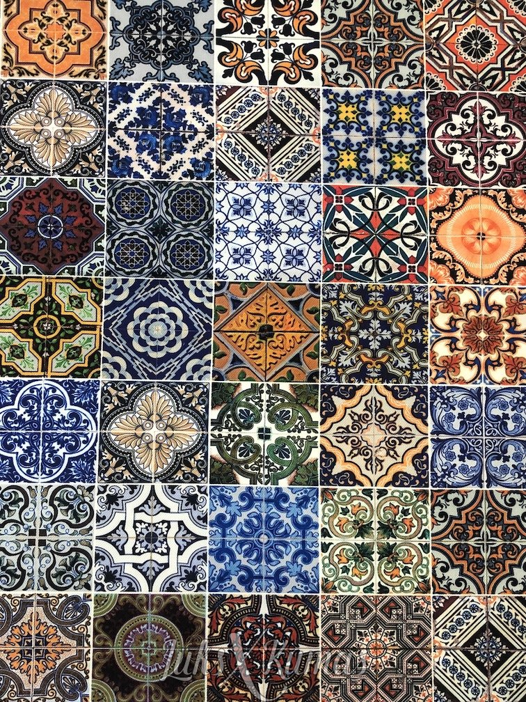
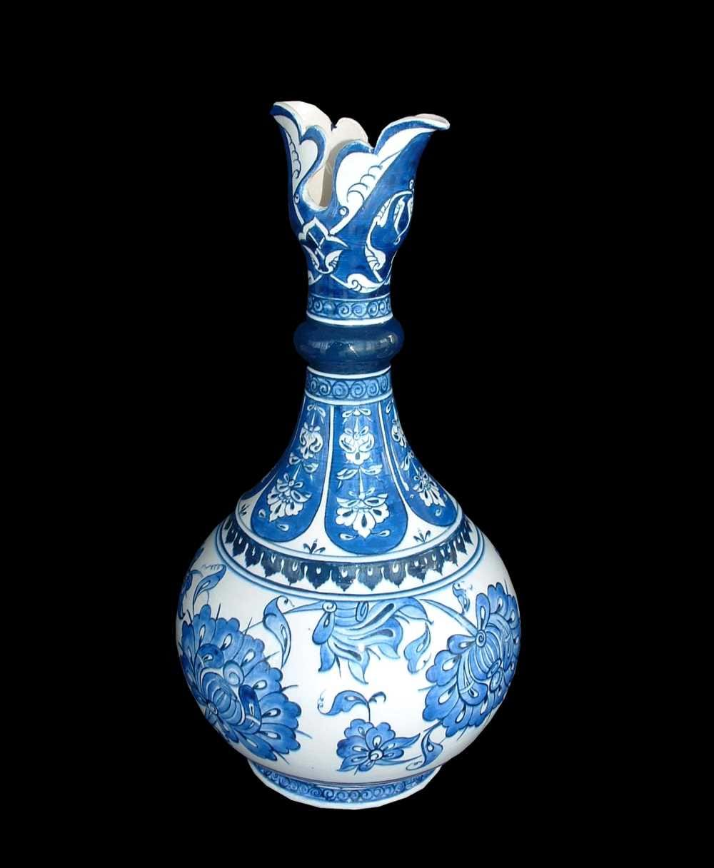
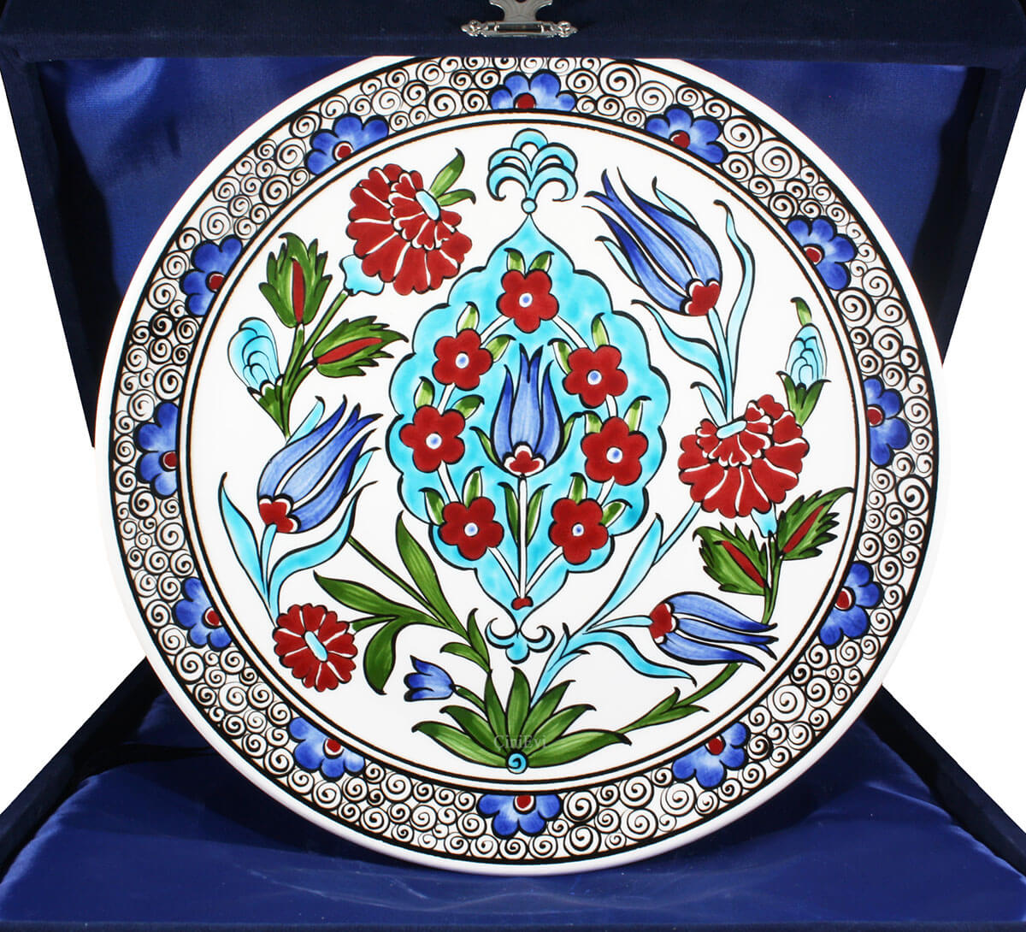
Tıle art
Tile, which is one of the most important traditional Turkish Arts, is generally used for architectural works, mosques, mansions. palace, fountain, mausoleum etc. It is a ceramic product used in interior and exterior decorations of buildings

Slide 11
Unification in diversity
Erasmus+ ka229 project
2020-1-PL01-KA229-081615_2

