Slide 1
'Clothing from my country
tells a story of national heritage'
ERASMUS+ KA229
2020-1-KA229-PL01-081615_6

Slide 2
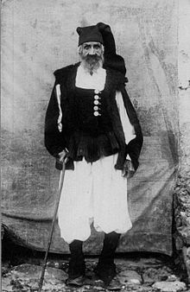
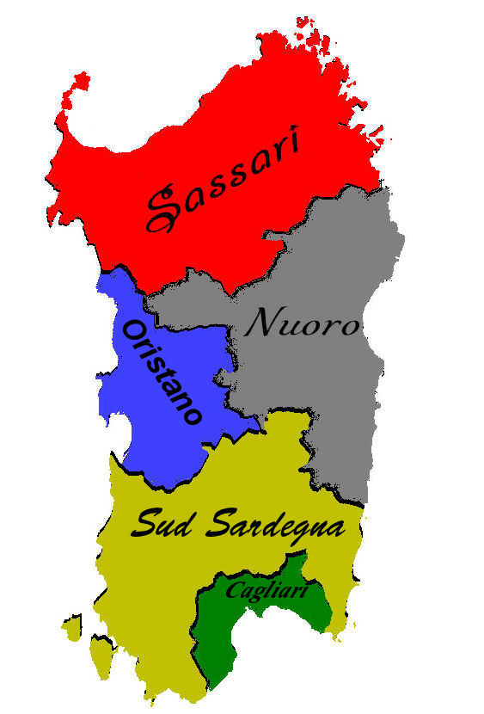
BERRITA- SARDINIA
A wool hat, usually tube-shaped and 150 centimeters long

Slide 3
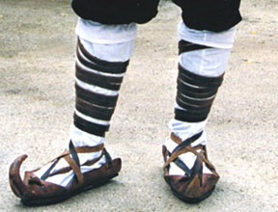
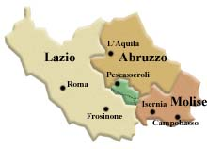
CIOCIA-LAZIO,ABRUZZO E MOLISE
A typical shoe of regions if central Italy that was worn by farmers and shepherds

Slide 4
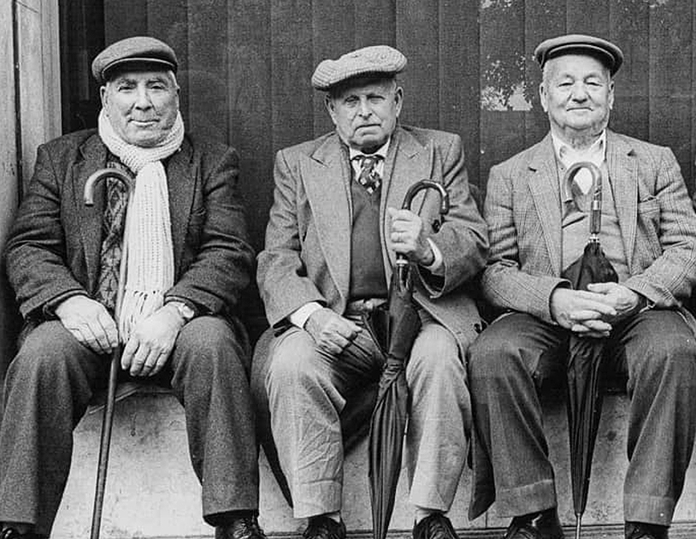
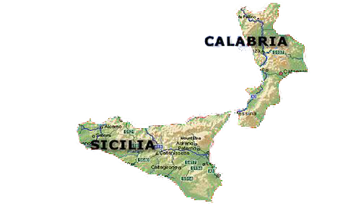
COPPOLA-SICILY AND CALABRIA
One of symbols of Italian style in the field of fashion.
It arrives in Sicily from England.

Slide 5
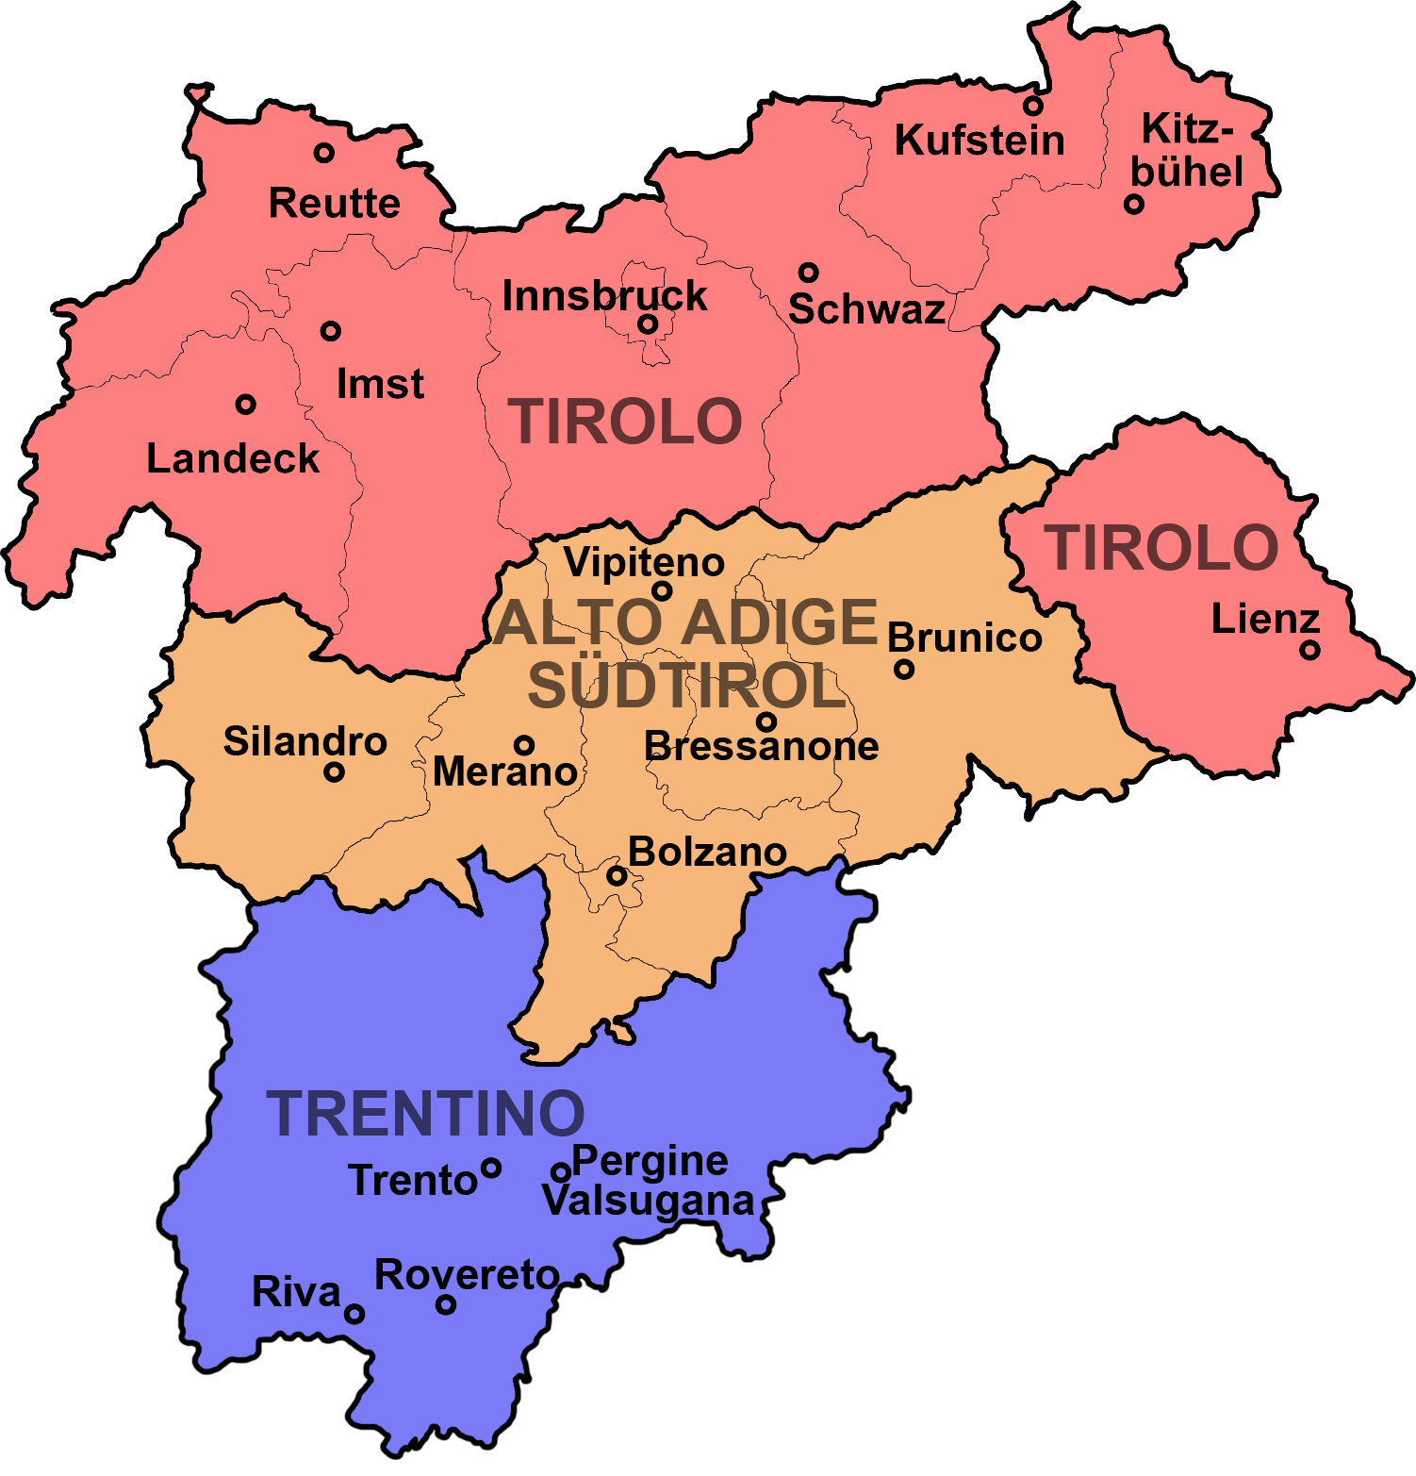
DIRNDL-TRENTINO ALTO ADIGE
A wide skirt and an apron associated with scarves or vests

Slide 6
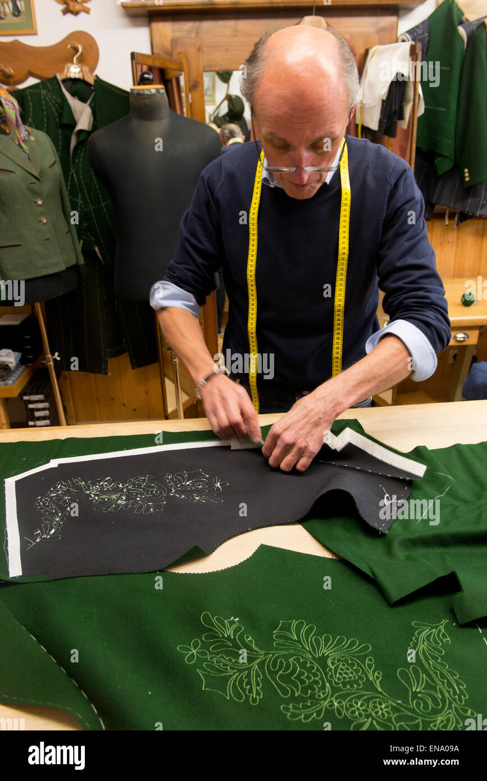
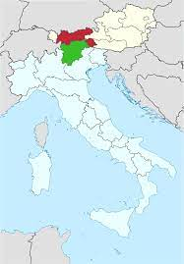
LODEN-TIROLO
A tissue of wool fabricated typical of regions between Austria and Italy

Slide 7
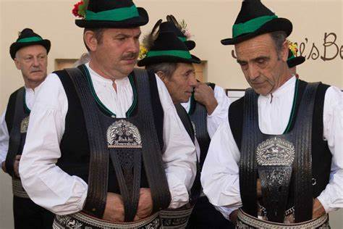
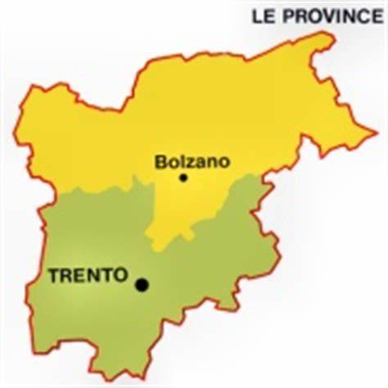
SARNER-ALTO ADIGE
A round neck cardigan originally black with colored edges. It was handmade with boiled wool.

Slide 8
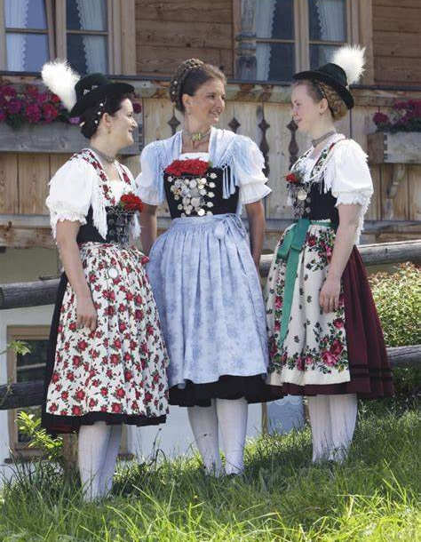
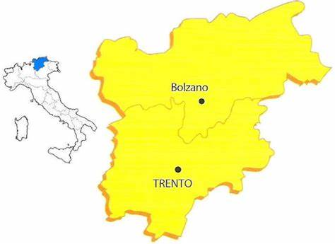
TRACHT-TRENTINO ALTO ADIGE
A traditional costume of Italy’s northern region. The hat, Tracktenhut, completes the costume.

Slide 9
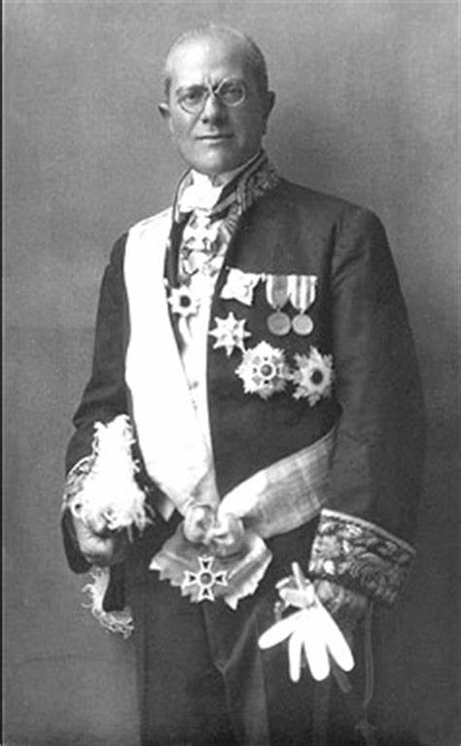
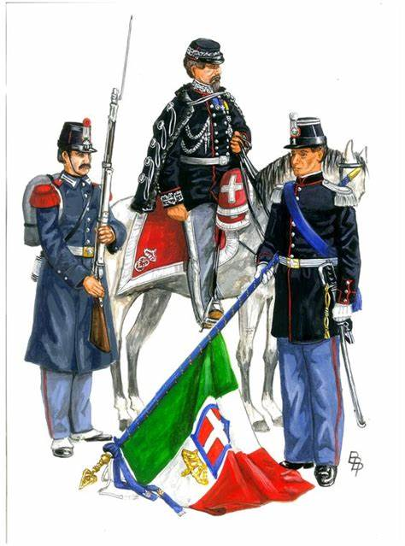
PREFECTURAL UNIFORM
It was introduced in Italy in 1859, but today only the badge remained.

Slide 10
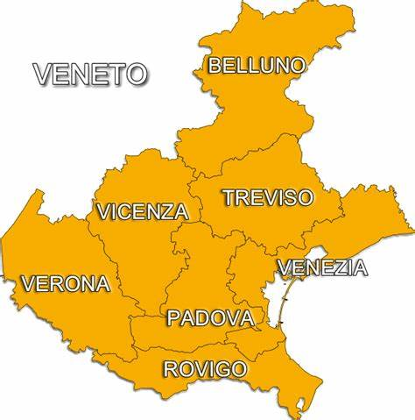
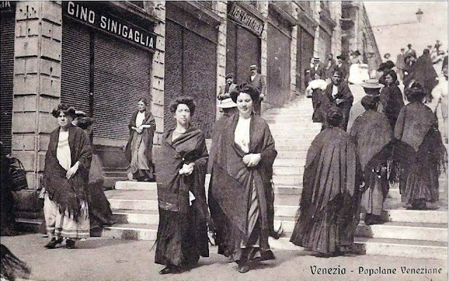
ZENDALE-VENETO
A wide and black shawl with long fringes, used mainly by Venetian women.

Slide 11
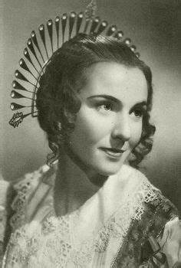
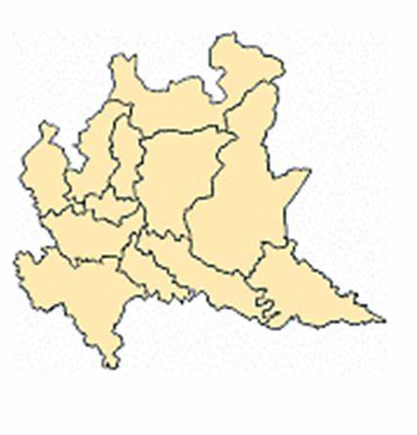
GUAZZE-LOMBARDY
A typical popular female hairstyle used in Brianza between XVII and XIX century.

