Slide 1
Cookery Book

Slide 2
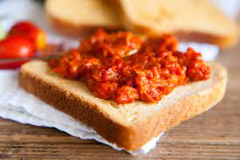
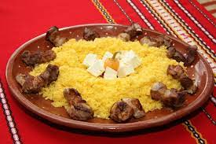
Macedonian
Traditional food
Appetizers
ajvar
Appetizers
bakrdanik
1
2

Slide 3
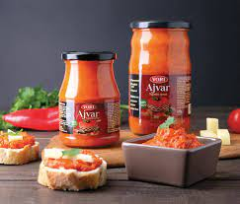
Preparation
ajvar
Roast the paprika and eggplants over charcoal or a gas flame, or bake them in a preheated 475 F oven, until the skin is blistered and darkened. Place the roasted vegetables in a paper bag and let them steam in their own heat for 10 minutes.....................
Ingredients
8-12 fresh red paprika (mild or medium-hot, to taste)
4 medium-size eggplants
1/2 to 3/4 cup olive oil
1 large onion, minced
3 large garlic cloves, chopped
1 to 2 tablespoons lemon juice (or 1 tablespoon red wine vinegar)
Salt and pepper to taste
Chopped fresh parsley for garnish
Calories: 99
Healtier Version
Wash the eggplants and cut …………………………………………………………..
3
4

Slide 4
Preparation
bakrdanik
In a deep bowl, mix the cheese, sour cream and sour cream with the mixer. Cut the bacon into small cubes and set aside until ready to use. Grate the cheese finely and also set it aside until use. Add salt to the water and bring it to a boil, reduce the heat and slowly add the corn flour, stirring constantly. When the corn flour becomes thick and starts to bubble, while it is still warm, transfer it to the bowl with the mixed cheese, sour cream and cream. Mix well with a mixer to combine. Fry the bacon cubes in a pan. Serve the finished kachamak with finely grated cheese and hot fried bacon.
Ingredients
– 400 ml. water
– 2 pinches of salt
100 gr. corn flour
- 100 gr. fresh cream cheese
- 1 tablespoon of cream
– 1 tablespoon of sour cream
- 50 gr. cooked bacon
Calories: 817
Healtier Version
5
6

Slide 5
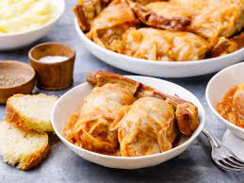
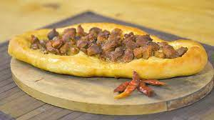
Macedonian
Traditional food
Main Courses
sarma
Main Courses
pastrmajlija
7
8

Slide 6
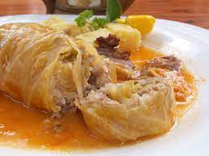
Preparation
sarma
Clean the onions and slice into cubes, do the same with the bacon. Fry quickly onions and bacon and add some chopped garlic near the end and add this to a bowl with the minced meat. Add some red pepper, salt, spices, rice, chopped parsley into the bowl.
Remove the leaves of cabbage and trim off thicker parts. Put a little of the meat mixture into each leaf, and wrap them. Wrap them so that you first fold one side over, then the other side, then roll.
Put some sliced cabbage on the bottom of a pot, then place a layer of cabbage rolls on top, lining them up in a circle.
Add enough water to cover the sarma, and cook for around 2 hours. Shake the pot occasionally. Add some roux at the end if you want.
Ingredients
1 sour cabbage head (around 2 kg)
500 g of minced meat (20 ounces)
100 gr. bacon (4 ounces)
1 teaspoon of red pepper
1 small cup of rice
2 onions
3 cloves of garlic
50 ml of oil
salt and spices
Calories: 485
Healtier Version
9
10

Slide 7
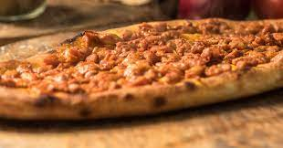
Preparation
pastrmajlija
The day before, cut the meat into cubes, add salt, put ground red pepper and leave it in the refrigerator.Leave the yeast with a little warm water and flour to rise. Knead the dough with yeast, a little salt and warm water, so that it is of medium strength. Let it double in size. Divide the dough into 8 balls. Form each one a little with a rolling pin, a little with your hands in this way. Order meat and some lard from above. It goes to baking, at 180 C, not long, about half an hour at the most. You can coat the crust all around with oil in which you have put some ground paprika and put it back in the oven for another 5 minutes. When you take it out, wrap it in kitchen paper, cover it with a cloth on top and let it rest.
Ingredients
Calories: 720
1 kg. flour
20 gr. yeast
a little salt, ground red pepper
800 gr. pork
a little lard
Healtier Version
11
12

Slide 8
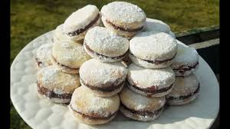
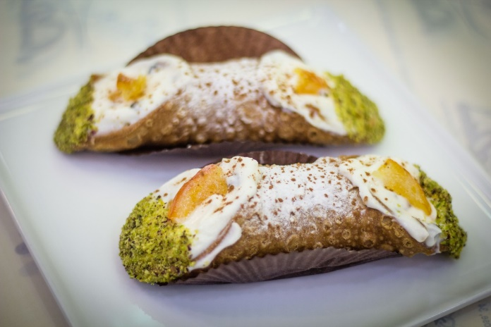
Macedonian
traditional food
Desserts
vanilici
Desserts
Cannolo
13
14

Slide 9
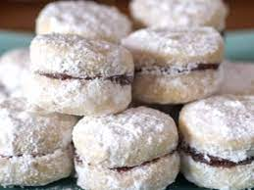
Preparation
vanilici
The pork fat, kept at room temperature, is beaten with a mixer, adding the sugar, vanilla, salt. When it all becomes creamy and foamy, add the lemon juice, then the yolk and the egg. Then add the finely grated lemon peel, the flour, mixing with a mixer while it is stirring, and then knead by hand adding the rest of the flour and chopped walnuts. A soft dough is obtained, which is stretched between two baking papers, with a thickness of half a centimeter. Shapes are taken out using a brandy glass. They are arranged on paper in a tray. Bake in a heated oven at 180 C for about 10 minutes or bake according to your oven. It is important that the top of the cookies remain white, and the bottom edge is browned. As soon as they cool down a bit, they are joined two by two with marmalade and rolled in scented powdered sugar with vanilla.
Ingredients
250 gr. Lard.
a pinch of salt .
125 gr. powdered sugar + icing sugar if necessary .
2 vanillas.
of 1 lemon - peel and juice.
100 gr. toasted chopped walnuts.
1 egg .
1 yolk .
550 gr. sifted white flour.
quince marmalade if needed .
Calories: 328
Healtier Version
15
16

Slide 10
Preparation
Cannolo
Wash the eggplants and cut them in little cubes, put them in a bowl and add salt.
Pour olive oil in a big pan, add the cutted onion and make it brown. Add a pinch of hot pepper, celery pieces and 2 lives cutted in half.
………………………….
Ingredients
Calories: 80??
INGREDIENTS TO COMPLETE THE
SICILIAN CASSATA
½ glass of rum
Sugar to taste
Water to taste
Candied fruit to decorate: candied pumpkin,
hinner sliced candied pumpkin, cherries,
oranges, pears, tangerines to taste
Healtier Version
Wash the eggplants and cut …………………………………………………………..
17
18

Slide 11
Enjoy your meal!

