Slide 1
Cookery Book

Slide 2
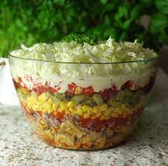
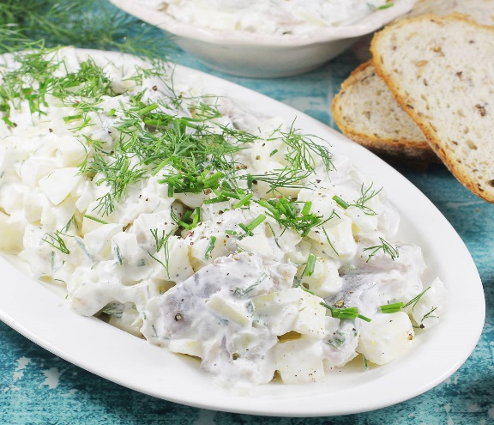
Polish
Traditional Food
Appetizers
Sledzie w smietanie
Appetizers
Sałatka gyros
1
2

Slide 3
Preparation
Sałatka
gyros
Peel Chicken filets, rince, clean and dice. Season with gyros and fry in a little olive oil. Dice the peppers, onions and cucumbers, drain the corn from the water. Cut the cabbage in half and then cut into thin strips. Put all the ingredients in a large bowl. In a cup, mix approx. Season to taste with pepper and salt.
Ingredients
Car 3 single chicken fillets
2 tablespoon gyros
1 medium red onion
1 large por
1 medium jar of pickled cucumber
1 can of corn
1 red pepper
½ cabbage
4 tablespoon of spicy ketchup
2 tablespoon of vegetable oil
2/3 cups of mayonnaise
1/3 cup of thick cream
Calories: 130
Healtier Version
Replace mayonnaise and cream with natural yoghurt.
3
4

Slide 4
Preparation
Sledzie w
smietanie
Slice the apples and onion into slices. Sprinkle apples and onions with lemon juice, add dill and horseradish, mix. Add cream to the apples with onions , season with sugar, salt and pepper. Cut the harring and mix it with the cream sauce. The harring tastes best after a few hours, when all the flavors have come together.
Ingredients
500 ml of sour cream
8 matias herring fillets
3 apples
2 onions
2 tablespoons of sugar
1 tablespoon of chopped dill
1 teaspoon of horseradish
Lemon juice
Salt
Pepper
Calories: 309
Healthier Version
Use low fat cream.
5
6

Slide 5
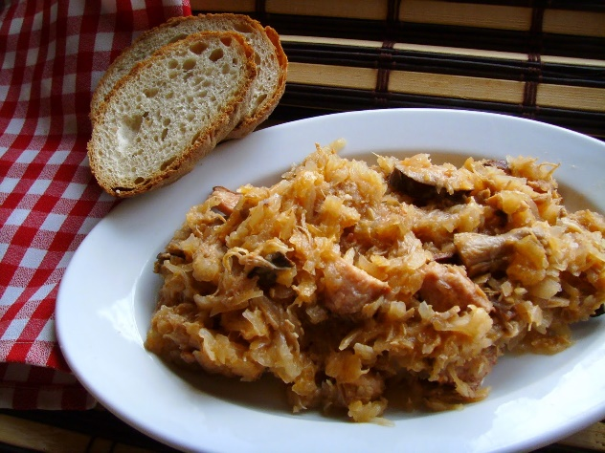
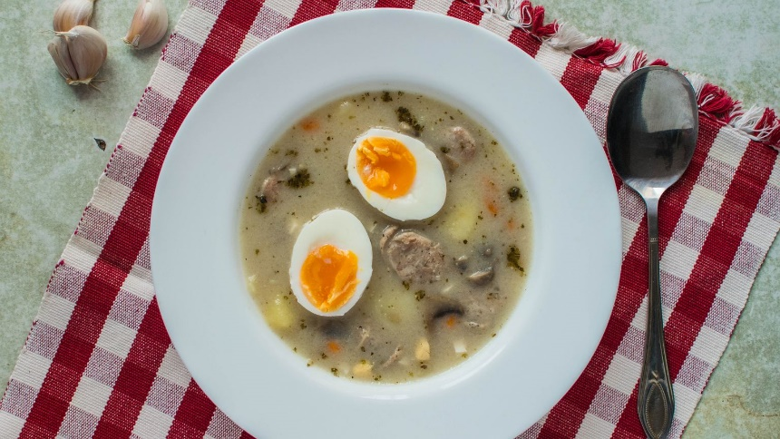
Polish
Traditional Food
Main Courses
Zurek
Main Courses
Bigos
7
8

Slide 6
Preparation
Zurek
Pour water into the pot. Peel and wash the carrots, parsley and celery. Also wash the rest of the greens. Then add to the pot along with the bay leaf and allspice. Boil it all for about 30 min. Meanwhile, fry the dicer sausage and onion. Add the fried to the boiling broth. Then add the leaven and garlic pressed through the press. Season taste with salt, pepper and marjoram. Boil the eggs and add to the soup. Boil it all for a few more minutes.
Ingredients
Celery 100 g ½ piece
Parsley 50 g 1 piece
Leek 140 g 1 piece
Onion 450 g 3 pieces
White sausage 200 g
Smoked bacon 100 g
Sourdough for sour rye soup 500 ml
Oil with Garlic 30 ml
Quai eggos 95 g 8 pieces
Carrots 100 g 2 pieces
Bay leaf 3/5 g 2 pieces
Allspice 4/5 g 4 pieces
Fresh marjoram 30 g 1 handful
Pepper, salt
Water 2000 ml 2 liters
Calories: 350
Healthier Version
Give up sausage and do not thicken with flour.
9
10

Slide 7
Bigos
Preparation
nnn
Brown pork and spareribs in a large heavy pot. Add smoked pork with 1 cup of water and simmer until 1 hour. Add the sauerkraut and one cup apple juice. 4 chop the cabbage fine and add to sauerkraut. Add lots of pepper and salt cover and simmer 1 hour. Remove lid and keep pot on a very low simmer. In a pan, fry bacon until crips, then crumble into sauerkraut mixture. Remove most of the bacon fat and fry onions and flour. Mix. Cut sausage and tomatoes. Bring to a boil, simmer 30 minutes and serve hot.
Ingredients
4 ibs sauerkraut
1 cup apple juice
1 ib smoked pork
1 ib spareribs
¼ ib bacon
1 cups tomatoes
2 cups water
2 bay leaves
Pepper, salt
4 ibs cabbage
1 ib pork loin chop or pork ribs
1 ib smoked sausage
½ cup onions (chopped)
16 ounce muchrooms (fresh)
2 tablespoons flour
Calories: 225
Healthier Version
Made on the basis of fresh white cabbage
11
12

Slide 8
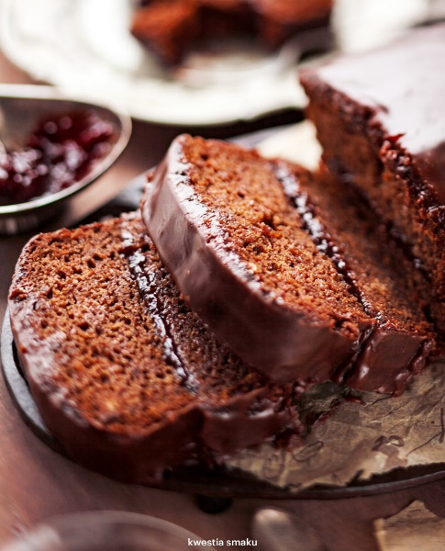
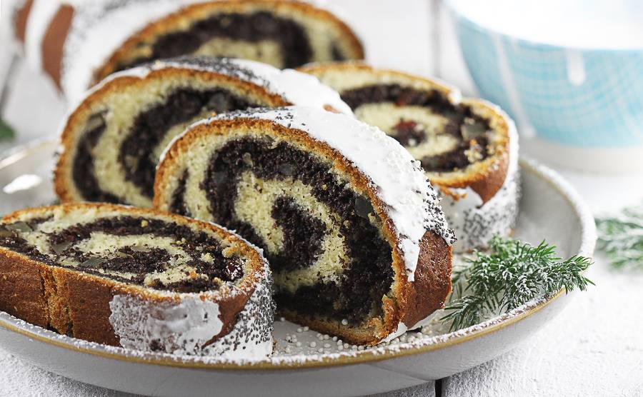
Polish
Traditional Food
Desserts
Piernik
Desserts
Makowiec
13
14

Slide 9
Preparation
Piernik
Melt margarine and cool. Beat eggs with sugar to stiff peaks. Add in the order of milk, cocoa, flour mixed with baking soda and spice for gingerbread. Stirring constantly, add plum jam. Then pour the fat and mix until homogenous. Add raisins and mix with flour.
Ingredients
40 d flour
12.5 g margarine
25 g sugar
2 eggs
4 tablespoons plum jam
3 tablespoons of cocoa
1 package gingerbread spice (40)
1 cup milk
1 teaspoon baking soda
About 1 ½ cup raisins
Calories: 356,1
Healthier Version
Replace sugar with xylitol and use dark chocolate for the glaze.
15
16

Slide 10
Preparation
Makowiec
Put the poppy seed mass into the bowl of a blender, mix with the ground almonds. Gradually add eggs and mix after each addition for about 30 seconds. Keep mixing and add: raisins, chopped nuts, diced apricots or orange peel and coconut flakes.
Ingredients
500 g of wheat flour
50 g of fresh yeast
50 g of sugar
200 ml of milk
4 yolks
50 g of butter
Poppy seed mass
850 g of ready-made poppy seed mass
2 tablespoons of breadcrumbs
4 proteins
Calories: 355
Healthier Version
Use non-candied fruit
17
18

Slide 11
Enjoy your meal!

