Slide 1
Cookery Book

Slide 2
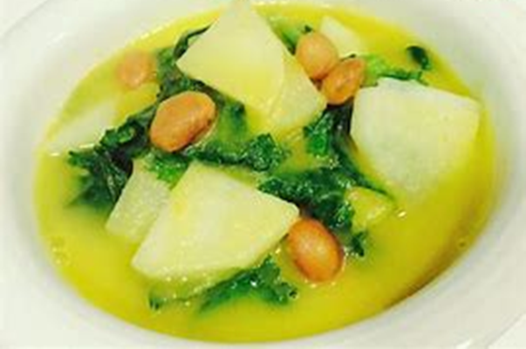
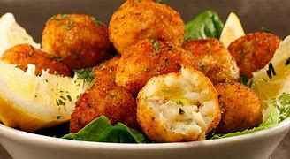
Portuguese
Traditional Food
Appetizers
Bolinhos de Bacalhau
Appetizers
Caldo de nabos
1
2

Slide 3
Preparation
Bolinhos
de
bacalhau
Bake the cod and then shred the cod, add the potato, the eggs and parsley and stir everything until they are well aggregated.
Then with that dough make balls using two table spoons. Then heat the oil and when it is hot lay the dumplings to fry.
And our cupcakes are ready.
Ingredients
700 g of cod
3 eggs
1 cup of parsley
Frying oil
1 kg of boiled and squeezed potatoes
3
4

Slide 4
Preparation
Caldo
de
nabos
Remove the vine from the turnips and wash all the vegetables.
Then cut one turnip, the potatoes, onions, carrots and leek into pieces. Bring to heat with water and cook for 20 minutes. Meanwhile cut the other turnips into cubes and their branches into small pieces, rinse them and let dry.
Remove the pot from heat and reduce its content to puree.
Take it back to heat and let it simmer while you add the turnips cut into pieces as well as the beans.
Stir and cook for another 12 minutes. Add the olive oil and season with salt. Stir, boil and serve immediately.
Ingredients
200gr of leek
200g peeled potato
200gr peeled onion
200gr of peeled carrots
4 turnips with vines
400gr of boiled butter beans
9
10

Slide 5
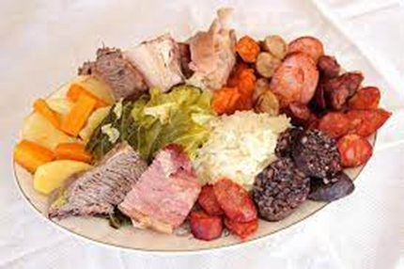
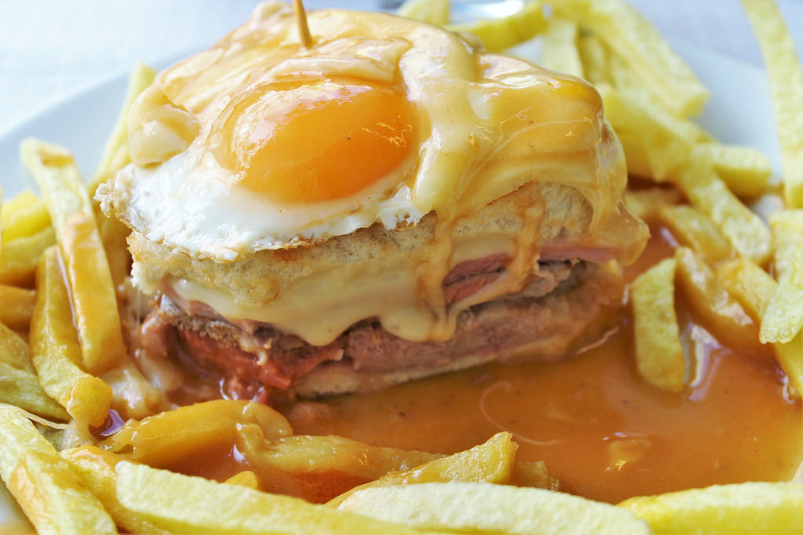
Portuguese
Traditional Food
Main Courses
Cozido a Portuguesa
Main Courses
Francesinha
7
8

Slide 6
Cozido a Portuguesa
Arrange the meats, season the pork with salt and let it rest in the cold overnight. On the day, rinse them with water and cook them with the remaining meats, the chicken cut into small pieces, the meat chorizo and the farinheira in water seasoned with salt, bay leaves and peppercorns. Remove and set aside as they cook.
Arrange and wash the cabbage, peel and wash the carrots and potatoes, cut them in half, boil all these ingredients in the meat cooking water and remove.
Then use 8 dl of the broth, adjust the seasoning, cook the blood sausage and remove. Add the red beans to the same broth, let it heat up and remove.
Peel and chop the onion and garlic, place in a pan, add the oil, boil it and let it sauté a little. Add the rice, mix well, add the blood sausage broth, stir, cover and cook over a very low heat for 16 minutes.
Serve the meat and sausages cut into pieces with the vegetables, carrots, rice and beans.
Ingredients
600 g of cow shank
600 g of spare ribs
600 g of bacon
2 pig ears
1/2 chicken
1 meat chorizo
1 blood sausage
1 farinheira
1 large can of red beans
400 g of rice
6 small potatoes
3 carrots
1 small savoy cabbage
1 small Portuguese cabbage
Salt and pepper in grains q.b.
1 onion
2 garlic cloves
0.5 dl of olive oil
2 bay leaves

Slide 7
Preparation
Francesinha
Prepare the sauce: peel the onion, chop it coarsely, put it in a pan, add the margarine and the bay leaf, bring to the boil and cook until golden. Add the tomato pulp, beef stock and beer and bring to a boil. Dissolve the cornflour in a little milk and add it to the pan, in thread, stirring constantly. Rectify the salt, season with spice, stir, add the brandy and Port Wine and bring to a boil. Pass through the mesh strainer and return to a low heat to warm up.
Cut the sausages in half, then in half lengthwise again and season with salt and pepper. Also cut the sausages in the same way. Also season the steaks with salt and pepper. Grill the steaks, sausages and sausage to taste.
Lightly toast the slices of bread and distribute two slices on two plates. Cover with a slice of ham, then add the steak and place another slice of bread. Then add the sausage and sausage, cover with a slice of cheese and the rest of the bread. Then add three slices of cheese on top of each set, bake at 200°C until melted, remove and serve hot drizzled with the sauce.
Ingredients
slices of bread
8 slices of cheese
2 small beef steaks
2 fresh sausages
2 sausages
2 slices of ham
Salt and pepper q.s.
For the sauce;
1 onion
4 dl of beer
3 tablespoons of tomato pulp
0.5 dl of brandy
0.5 dl of Port Wine
1 tablespoon of margarine
1 tablespoon (soup) of cornstarch flour
1 bouillon cube
1 bay leaf
Milk q.b.
Salt and spicy q.b
11
12

Slide 8
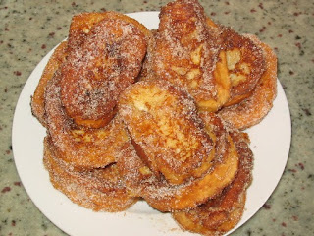
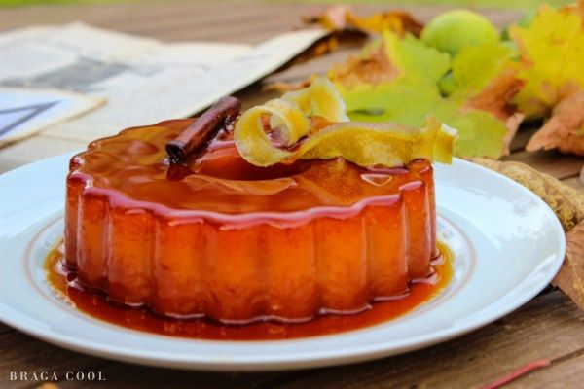
Portuguese
Traditional Food
Desserts
Pudim abade de Priscos
Desserts
Rabanadas
13
14

Slide 9
Preparation
Pudim
Abade
de priscos
Caramelize the baking pan. Then add the 150 g of sugar and 150 ml of water and bring to heat, until caramelized. Spread the caramel well to cover the walls and the base of the pan, let it cool and harden.
To make the syrup, put in a pan the water, the sugar, the bacon cut into slices, the cinnamon stick and the lemon peel. Stir to dissolve the sugar and bring to heat. When it starts to boil reduce to low heat and remove from heat.
Pour the syrup into a bowl. In another bowl undo the yolks with a spoon and add the Port wine. Then add the syrup, still hot. Pour the prepared dough into the caramelized cooking pan. Place the pudding to cook for 45 minutes and remove it. When it's cold, turn the pan upside down and let the pudding fall into a deep plate.
And our pudding is ready.
Ingredients
Pudding-
15 gems
• 60 ml of Port wine
• 400 g of sugar
• 500 ml of water
• 50 g of bacon
• 1 cinnamon stick
• 1 lemon peel
Caramel-
• 150 g of sugar
• 150 ml of water
15
16

Slide 10
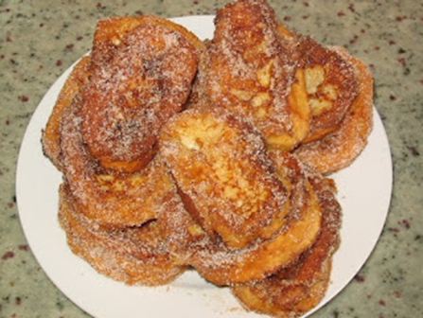
Preparation
Rabanadas
Boil the milk with the cinnamon stick, lemon zest and sugar for 10 minutes over medium heat.
Take from heat and discard the cinnamon stick and lemon peel.
Dip the slices of bread through this milk and then through the beaten eggs that are in another bowl.
Fry them in hot oil, on both sides, until golden.
Drain, sprinkle with cinnamon and sugar and enjoy!
Ingredients
- a loaf of bread cut into slices
1lt milk
5 eggs
lemon (zest)
frying oil
a cup of sugar
Cinnamon stick
Powder cinnamon
17
18

Slide 11
Enjoy your meal!

