Slide 1
Cookery Book
TURKEY

Slide 2
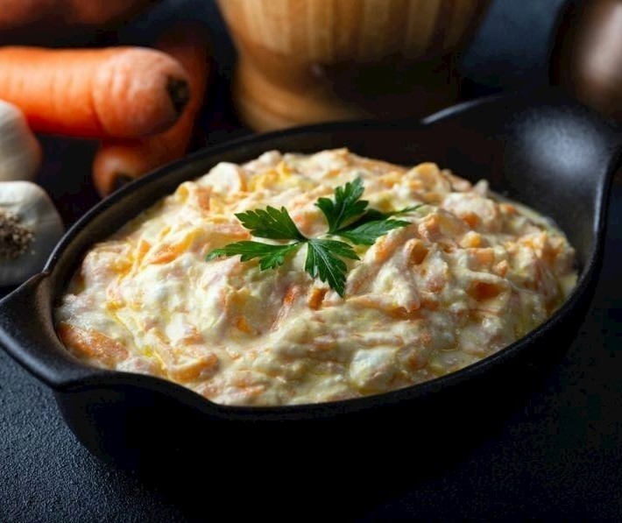
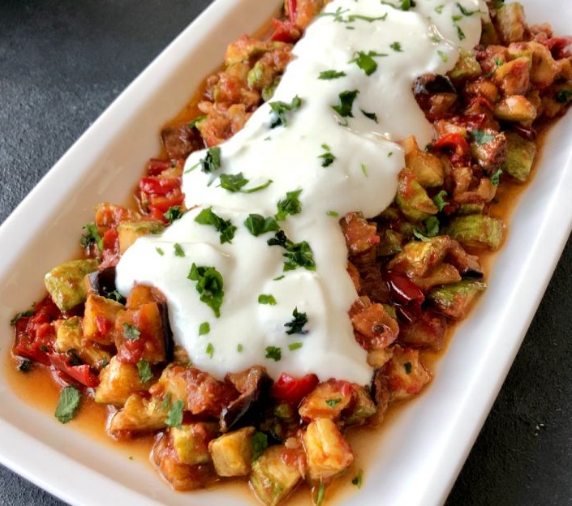
Turkish
Traditional Food
Appetizers
Carrot Tarator
Appetizers
Saksuka
1
2

Slide 3
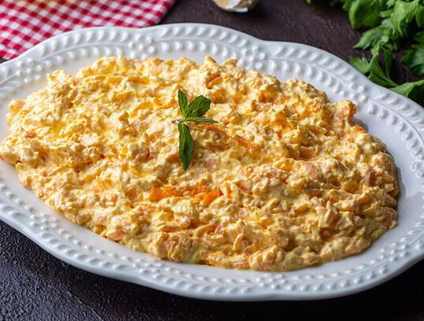
Preparation
Carrot
Tarator
First grate the carrots. Then add olive oil in a pan and put the carrots. Fry for 3-5 minutes (until soft). Wait for it to cool down . Put yoghurt in a large bowl, strained yoghurt (not necessary, you can only use yoghurt), mayonnaise (According to your desire but mayonnaise that makes it taste better in our opinion) Add the cooled carrots,walnuts, salt and grated garlic (you can use garlic if you want ) to the yogurtbowl. And mix well. Finally, take it to the plate you will serve and you can add olive oil and mint on it and decorate it if you want.
Ingredients
2 carrots
5 spoon yoghurt
3 spoon strained yoghurt (İf you don't want to use strained yoghurt , you can use yoghurt instead of it )
Mayonnaise
2 cloves of grated garlic
5-6 walnuts
1 teaspoon salt
Calories: 80??
Healtier Version
3
Use less olive oil
4

Slide 4
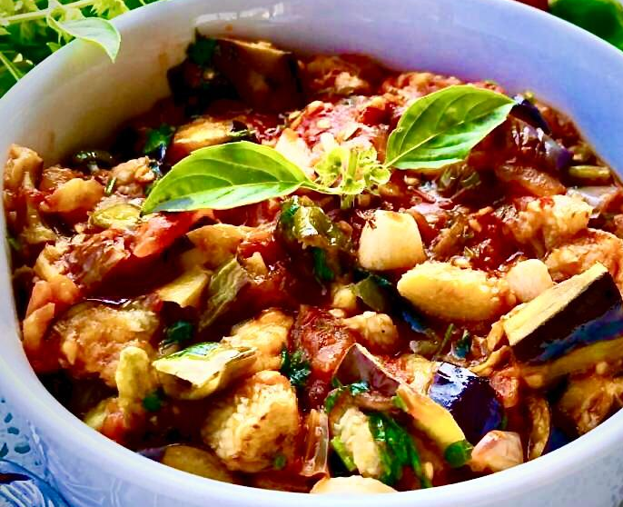
Preparation
Saksuka
Eggplants are cut into cubes. It is kept in salty water to debitterness. Eggplants are fried in hot oil. Wait it on a napkin to drain excess oil.
For Sauce
Pepper and onion are finely chopped and tomatoes are cut into cubes. Garlic is either crushed or chopped. To prepare the sauce, 2-3 tablespoons of oil is put in the pan. Pepper, onion and garlic are roasted in this oil. Add tomato paste and continue roasting. After a while, tomatoes, sugar, spices and salt are added. Water is added after the tomatoes are roasted a little. When the water is darin, the sauce is mixed with the eggplant.
Ingredients
4 eggplants
1 dessert spoon salt
oil for frying
For sauce
3 green peppers
1 onion
4 gloves garlic
4 tomato
1 dessert spoon tomato paste
1 cup water
1 teaspoon granulated sugar desired spices
Calories: 80??
Healtier Version
5
Wash the eggplants and cut
6

Slide 5
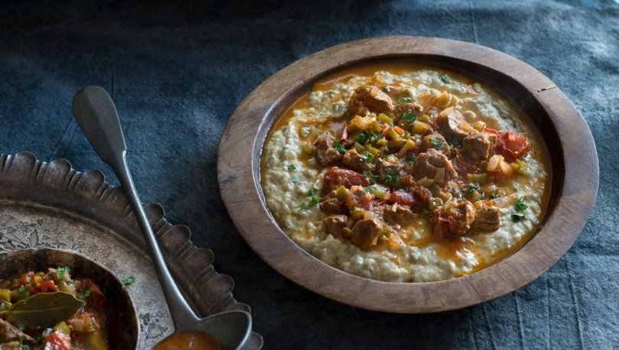
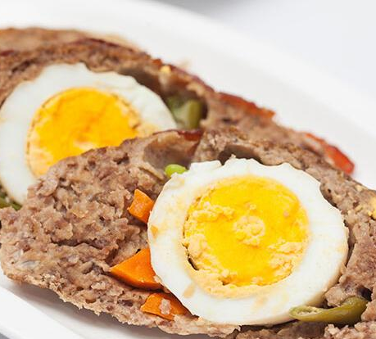
Turkish
Traditional Food
Main Courses
Hunkar Begendi
Main Courses
Dalyan Kofte
7
8

Slide 6
Preparation
Hunkar
Begendi
1. Make holes in 4 eggplants and put them on the stove tray. Leave them in oven for about 20 minutes in 200 degrees (Celcius).
2. Put the baked eggplants on a container and wrap it with plastic wrap to get the eggplants to be easily peeled, after waiting for 15 minutes peel the eggplants.
3. Roast 3 tablespoons of olive oil in a pan. Then add 2 chopped onions and fry them until they get pink.
4. After adding 4 cloves of garlic add the 600 gr of your choice of meat (lamb or beef).
Ingredients
For the meat;
600 gr of lamb's quarter
2 medium sized onion
4 clove of garlic
3 tablespoon olive oil
3 medium sized tomato
1 tablespoon of tomato sauce
2 glass of warm water
1 tea spoon of salt
For Begendi ;
1/2 glass of melting cheese
1 tablespoon butter
1,5 glass of milk
4 medium sized eggplant
1,5 tablespoon flour
1 teaspoon salt
1 teaspoon pepper
9
10

Slide 7
8. Add the baked and peeled eggplants on it. Slowly add 1,5 glass of milk and always stir. Add 1 teaspoon of salt and pepper.
9. Then lastly add a half glass of grated kashar cheese and mix then take it from the stove.
10. Put the softly cooked meat on the beğendi.
Hunkar
Begendi
Preparation
5. Leave them to be cooked until the meat is out of water. Then add 1 tablespoon of tomato sauce, 1 teaspoon of pepper, 1 teaspoon of salt and 3 peeled, diced tomato.
6. After adding 2 glass of hot water wait until the meat gets softer.
7. Let's get to the beğendi. Melt 1 tablespoon of butter in a pan. After adding 1,5 tablespoon of flour fry it until the scent gets out.
Calories: 80??
Healtier Version
Use less olive oil
9
10

Slide 8
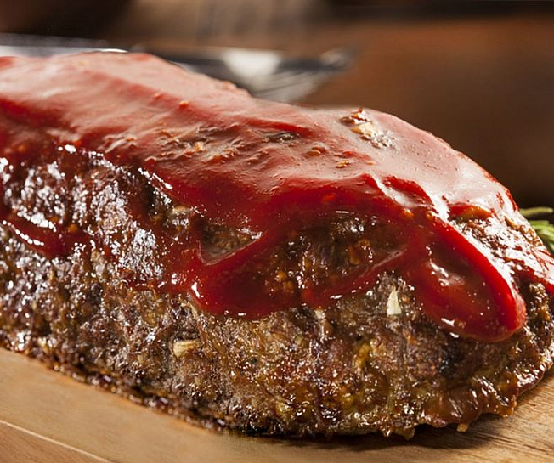
For the sauce;
5-6 tablespoons of olive oil,
1 heaping tablespoon of tomato paste,
1.5 cups of water,
Salt.
For the filling;
3 eggs
700 g canned mixed vegetables
Dalyan Kofte
Ingredients
For meatballs;
500 g of medium-fat ground beef,
1 onion,
3 tablespoons of breadcrumbs,
1 egg yolk and half of 1 egg white,
Cumin,
Black pepper,
Salt.
For topping;
Half of 1 egg white.
Preparation
Boil the eggs in solid form for the filling. For the meatballs, knead the ground beef, egg yolk and half of the egg white, grated onion, breadcrumbs, cumin, black pepper and salt in a deep bowl.
11
12

Slide 9
For the sauce, heat the olive oil in a pan and add the tomato paste and stir fry until smells good. Add the water and salt and mix. Simmer for a few mins. and remove from the heat. Transfer the meatloaf into a properly sized ovenware. Pour the sauce over. Place the remaining canned mix vegetables in two sides. Return it back to the oven and bake for 10 mins.
Dalyan Kofte
Preparation
Spread greaseproof paper on a baking tray. Spread the meatball mixture in a rectangular shape on the wax paper. Sprinkle half of the canned vegetables on top. Place the eggs in the middle. Fold the meatloaf with the support of greaseproof paper from both sides and join it in the middle. Spread the half egg white on top. Bake in a 200 C degrees preheated oven golden brown
Calories: 80??
Healtier Version
Use less oil
11
12

Slide 10
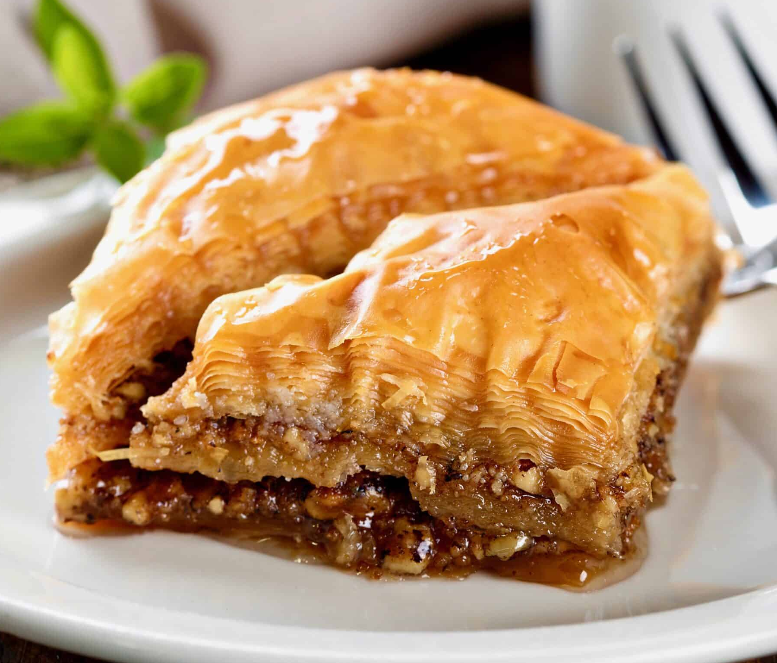
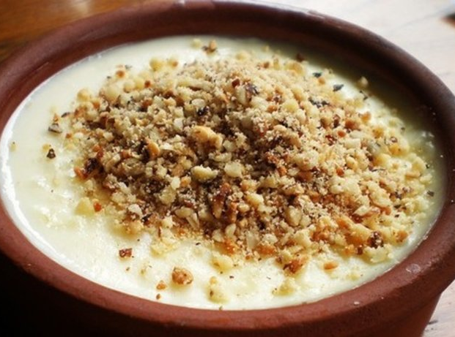
Turkish
Traditional Food
Desserts
Baklava
Desserts
Sutlac
13
14

Slide 11
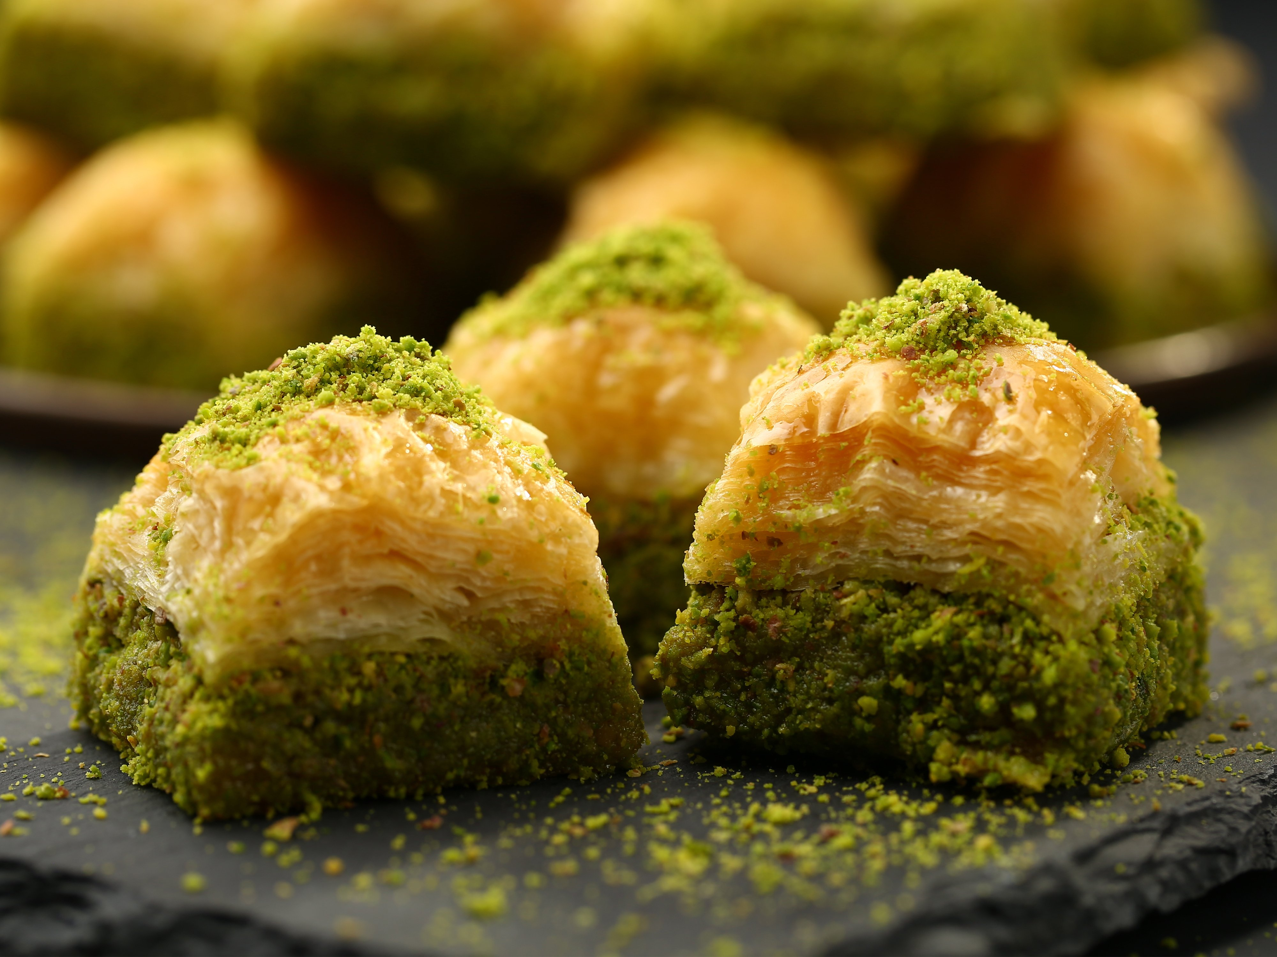
Preparation
Firstly , put the flour , egg , salt and water in a bowl and knead it. Divide the dough evenly twelve pieces and make the dough pieces into round. Pour farina in a tray and put the dough pieces and cover it with stretch film and rest 1 hour in the fridge.- Roll out the six of the dough pieces with farina . Put the melted butter in baking tray and put the dough on it and add evenly pistachio on the dough. Roll out the five of the dough pieces and put it on the pistachio and roll out the last pieces of the dough and put it on the tray. Then , cut it the model you want it. Melt the butter and add it on the baklava and bake it 180 degree oven for 1 hour. Put the 3 glasses of sugar and 3,5 glasses of water in a pot and boil it for 15 minutes. Pour the syrup on the baklava after it's cooked
Baklava
Ingredients
3 glasses of flour
1 egg
1 teaspoon salt
1 glass of water
125 gram butter
150 gram pistachio
3 glasses of sugar
3,5 glasses of water
Farina
Calories: 80??
Healtier Version
15
Wash the eggplants and
16

Slide 12
Preparation
Sutlac
First, wash the rice well. After washing it, boil it with 2 glasses of water until it is cooked. Keep it a little in the water. Add milk and vanilla on boiled rice and boil. Pour in the bowl 3 tablespoons of wheat starch with half a glass of milk and mix. On the other hand, when the mixture on the stove starts to boil, add the sugar and starch mixture and boil for 10-15 minutes more and turn off the heat. Share your rice puddings in refractory rice pudding bowls suitable for the oven. Fill the tray with cold water and place the rice pudding pots on the baking tray (the water in the tray will reach half of the rice pudding bowl). Put the tray on the top shelf of your oven. Cook at 180 degrees until your rice puddings are browned.
Ingredients
1 liter milk
1 glass granulated Sugar
3 tablespoons wheat starch
1/2 glass rice
1 packet vanilla
1/2 glass milk to liquefy the starch consistency
2 glasses water
Calories: 80??
Healtier Version
Wash the eggplants and cut
17
18

Slide 13
"This project has been funded with support from the European Commission. This publication reflects the views only of the author, and the Commission cannot be held responsible for any use which may be made of the information contained therein."
Enjoy your meal!

