Slide 1
ERASMUS+ KA229 PROJECT
2020-1-PL01-KA229-081615
The craftmanship in our countries
Macedonian craftmanship

Slide 2
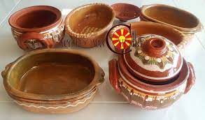
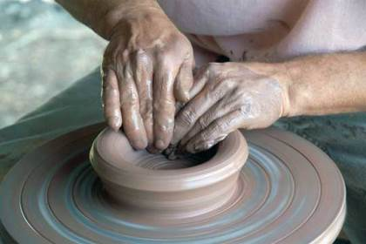
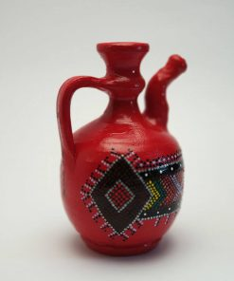
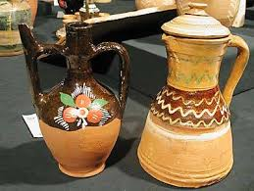
Macedonia is a country where tradition carries a lot of weight. The cultural expression, more or less, thrives by paying homage to traditional and ethnic elements. So it goes that Macedonian music, architecture, even food, stylistically tilt towards the past – being its mirror, teaching us volumes about Macedonian history and tradition. And if there is a single vertical where Macedonian history and culture express themselves together, that must be in Macedonian handicrafts.
The pottery in Macedonia dates back to the Paleolithic period (Old Stone Age) and has an important role in everyday life. Besides the practical application, the ceramics had also received important aesthetic artistic content that culminated in the time of the ancient period.
Passed through generations, as a family trade, crafts in Macedonia are well respected. And while most of them created the peak of production before the Second World War, some were, even back then, dedicated to cultural expression and decor only. Macedonian handicrafts of today, without interruption continue this same line.
The origin of different types of handicrafts can be traced back centuries ago, and throughout the territory of the country. Some cities were better known for a certain type of craft, where families kept the trade alive with every next generation.
The production of traditional ceramic products is a hallmark of Macedonia to this day. Potters produce top-notch works and each product is unique and has unique value. Pottery dishes are made of clay, most often on a potter wheel which is motioned with a leg and decorated in a primitive way, color, graphite and application of relief motifs. The prepared products are dried and sealed in special furnaces.
.

Slide 3
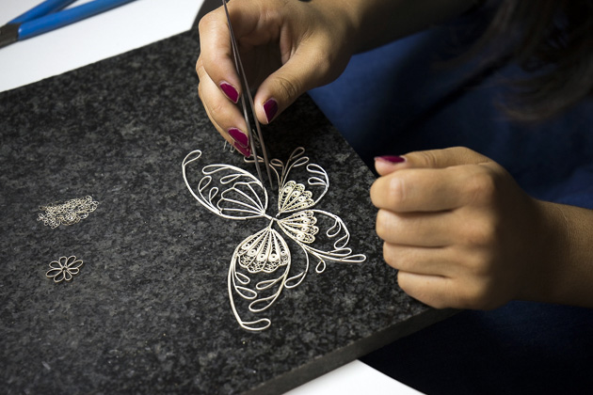
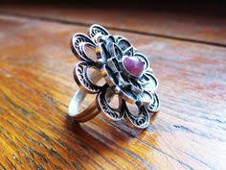
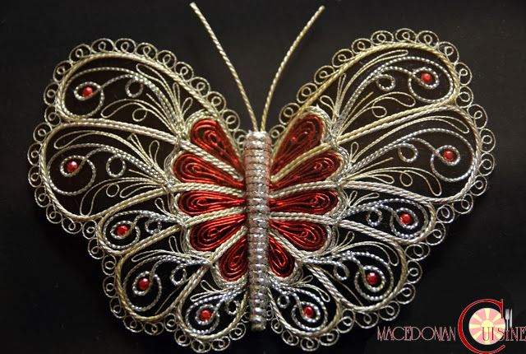
Macedonian Filigree
Filigree is an art with a long tradition. It is passed from generation to generation and requires a lot of patience, vision and above all, love in creating. Simple silver wires are intertwined miraculously. Each filigree has a history and heaviness in making it, and each one is unique, unique for its beauty and the mesh of the silver wire. The main feature of filigree is knitting a very thin, already processed wire called "srma". Sometimes the wire is thin as a fiber. Filigree is considered one of the finest and oldest techniques when it comes to processing of metal. By the mid-nineteenth century, this technique was named as wire-craft or working with wire. In fact, filigree is derived from the Latin words: filum (wire) and granum (grain), indicating the thickness of the wire in the hands of the filigree maker.
Silversmith is an art craft that represents an entire group of trades: silversmith with casting and hammering items, filigree, goldsmith and jewelers. For making filigree is needed the purest silver from 1000 carats which is obtained by refining (hardening) of silver with lower quality.
A number of operations are used for preparation of jewelry, including: whitening (silver jewelry is cleaned, polished), burnishing (cleaning, polishing), gilding (process in covering with gold), molding (process of making molds for casting), tempering (purification of silver for getting more carats), wire spinning (two wires are joined into one) and others.
Filigree in Macedonia had the biggest flourishing in the Middle Ages, reaching its climax in the XVIII century and the first half of XIX century. Craftsmen have a large contribution to the economic development of Macedonia. However, with the introduction of machine-products, there's a sharp decline in filigree too. Serial products are cheaper than handmade. Being in such an unenviable position, in the second half of the XIX century the majority of silversmiths have closed their shops reorienting to other activities or left abroad. Only the stubborn survived, so there are rarely silversmiths in the cities today. In fact, today there are quite a number of filigree and goldsmith stores, but in essence, they are commercial rather than creative shops.

Slide 4
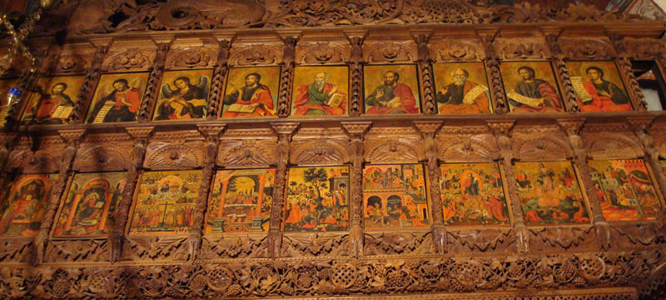
Wood-painted icons
Ancient Christianity themes, produced by various artists and techniques, closely resembling original icons from the ninth century and beyond; Original and authentic, the iconographers have preserved the technique and nowadays paint some of the most valuable icon paintings on wood.
While in Macedonia, you’ll probably visit a lot of beautiful Orthodox churches. This might inspire you to buy a couple of lovely painted wooden icons. You can find these items practically anywhere, from the old bazaars in different cities to the small shops located in various churches. They make great souvenirs, come in many different shapes and sizes, and most of them are reasonably priced. Finally, if you decide to purchase these icons, keep in mind that they are objects of great religious significance to believers and, as such, should be respected.

Slide 5
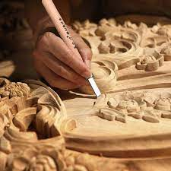
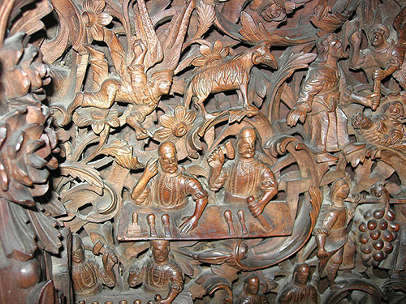
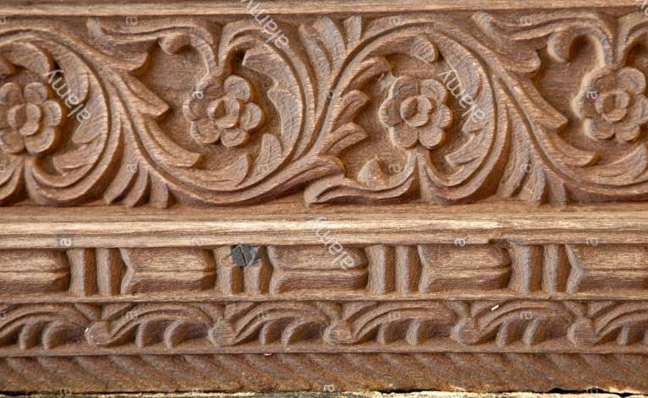
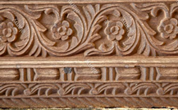
Wood Carving
Wood carving is one of most magnificent artifacts Macedonia can contribute to the global cultural heritage. For everyone visiting Macedonia the deep carved iconostases in the churches of the Holy Saviour (Sveti spas) in Skopje, St. Gavril in Lesnovo, near Probishtip, St. Nicholas in Krushevo and St. John Bigorski (Sveti Jovan) near Debar, are must-see cultural attractions. These pieces had brought the wood carving craft to the level of art. Their exceptional value lies in the high relief and fretwork in which the characteristics of the single material, the wood, are used to their utmost without any gilded surfaces or added colour.
The old decorative technique of woodcarving exists in many regions of the world. The tradition in Macedonia originated a thousand years ago, when this way of decorative sculpturing complemented fresco-painting as an integral part of the decorations of the old Byzantine churches erected throughout Macedonia after Byzantium re-established its rule over the country in the 11th century. The oldest such example are the wood carvings on the altar of the Ohrid Cathedral Church of St. Sophia.
Yet, scholars find connections between the ancient, medieval, 19th-century and present- day wood carving. There is a variety of motives repeatedly used over the centuries. There are fish, deer, lion, eagle, peacock, snake, figs, wine leaves, oak leaves and flowers. Such symbols are found on the burnt carved wood from the ancient site of Bargala, near Shtip, dating back to the 4th century. Woodcarving rapidly declined in the period before and after the First World War.

Slide 6
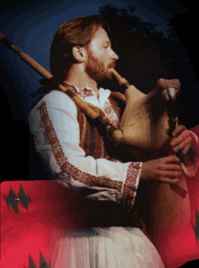
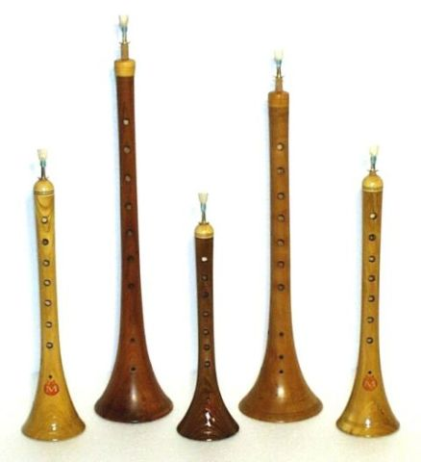
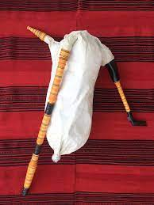
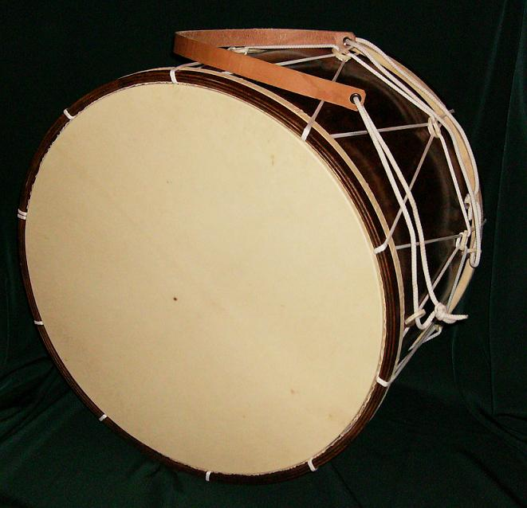
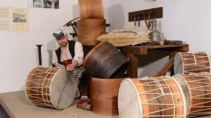
Traditional Music instruments
Making traditional musical instruments is a craft that still exists in Macedonia
Gajda
Tapan
Zurla
Macedonian’s version of the bagpie - its origins are in Macedonia’s mountain villages. Gajdas have four main parts: -the chanter (gajdarka) - a wooden tube with seven finger holes in front and a thumb hole at the back -the drone (brcalo) - producing the constand sound -The duvalo - a wooden pie attached to the bag where the musician blows air init -the bag itself (mev) - made of tanned sheep or goat skin. The gajda usually accompanied by a kaval or two, a tambura and perhaps a percussion instrument like the tapanche, dajre or tarabuka.
This is a good-size drum. What sets it apart is that the musicians of Macedonia play it with two specially designed drumsticks - known as a kukuda and a prachka. The kukuda is a narrow pipe made of wood, while the prachka is more like a thin switch. Each one strikes a different side of the drum and the difference in sound is remarkable; together they produce an impression that something big is about to happen. The tapan is the traditional accompaniment for most folk bands playing at special occasions. You will find it at the Galicnik wedding.
Typically played at weddings, social occasions and Turkish wrestling matches, the zurla has a distinct piercing sound that is usually heard well above the drum (tapan) that accompanies. It is a wooden two-part wind instrument, the body of which is a conical pipe. A beak (slavec) is inserted into the upper, narrow part.

Slide 7
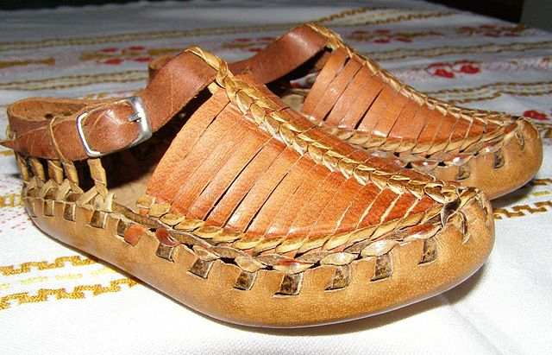
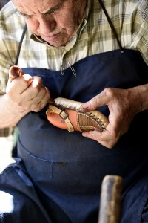
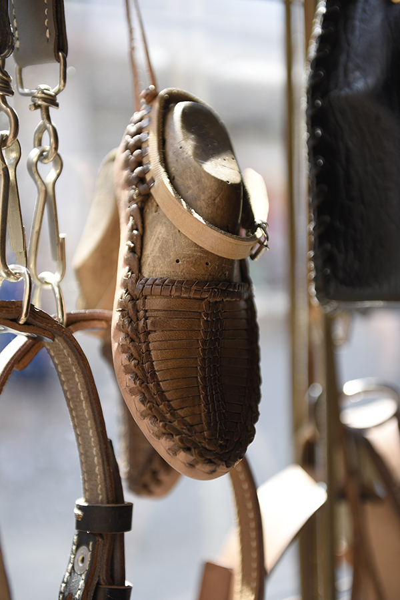
Traditional shoes
The leather and decorated footwear, the Macedonian traditional show, was produced throughout the country around beginning of the past century. Now, a craft kept alive by few, it still provides the ethno enthusiast with rare items.
Many preserved pairs are being part of someone’s collection, though there are still those who would gladly sell them for the right price. Each pair is handcrafted, and by design shows the region from where it came. With decorative elements, made almost exclusively from leather, they are a true piece of Macedonian handicraft treasure. You can nowadays, even find craftsmen who make then in different sizes, some even as souvenirs, or as a part of your key-chain.
The process of making Macedonian opinci lasts for several days (depending on the season). First, is cut a piece of calf or cow leather that is already tanned. Then, it is put in water to become wet. The time of how long the skin will stay in water depends on the thickness of the leather itself, which, in turn, depends on the tanning. "If the leather is thicker and harder then it must be watered for an extended period of time. And that depends on the tanning." One pair of opinci can't be imagined if they don't go through that process of watering. To produce a pair of opinci, the leather and the water are necessary. When the process of watering is completed, the size of the shoes will be determined and during all the time, the shoe is on a mold. With the help of this mold, the shape is determined. When the shape is determined, one piece of leather is sewn on the back, one strap in the middle and two more straps on the front. When the sewing process is completed, the opinci are carried on drying and don't depart from the mold fort two to three days depending on the daytime temperature. Until 50 years ago, opinci were usually worn in rural areas of the Balkan countries. Nowadays, they are only used in folk costume, for folkloric dance ensembles, festivals, feast days or other cultural events.

Slide 8
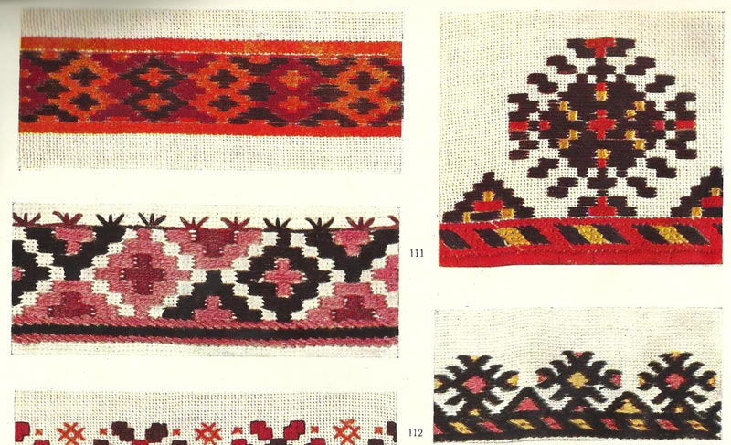
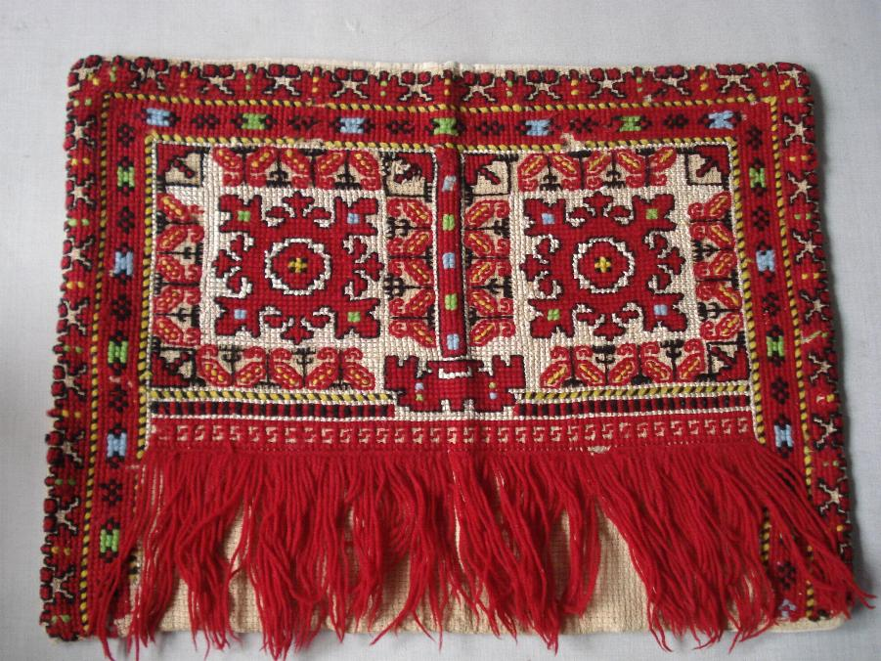
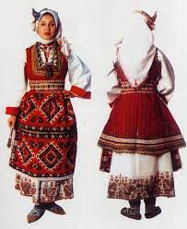
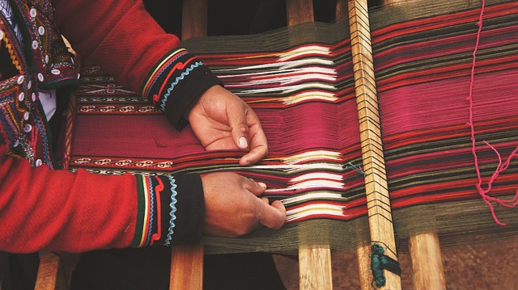
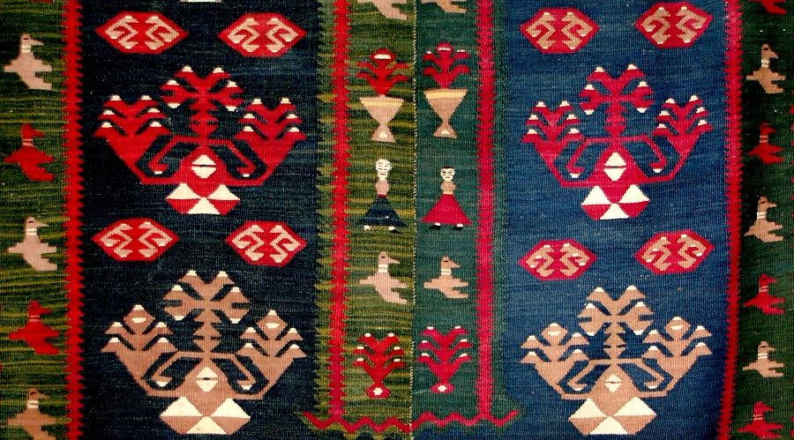
Clothing and textile items
MACEDONIAN EMBROIDERY
MACEDONIAN FOLK COSTUME
While traditional Macedonian costumes can cost upward to a real fortune, there are still artists who are devoted to such design. The range of items here is rather broad, including wearables, but small textile material as well. A chemise, a vest, a decorative collar, a headscarf, socks, detachable sleeves and of course an apron, all part of the Macedonian traditional vest, though available to be found separately.
Macedonian costume is the embroidery with luxurious and geometric patterns, srma and braids, as well as jewelry made of metal, silver, beads and fruits of nature. As a characteristic ornament, especially for women's costumes, mostly embroidered were the shirts and headbands. The color is dominated by the red color, although green, yellow and dark blue are also present. The Macedonian national embroidery clearly testifies the creative originality of its creator - Macedonian woman.
WЕLCOME to Macedonia
and enjoy
the works
of our craftsmen
The fabrics for the folk costumes were made by loom. The loom was also used to make carpets, and hand weaving, although rarely used today, is mainly used to make souvenir items.
Macedonian carpet

Slide 9
"This project has been funded with support from the European Commission. This publication reflects the views only of the author, and the Commission cannot be held responsible for any use which may be made of the information contained therein."
ERASMUS+ KA229 PROJECT 2020-1-PL01-KA229-081615

