Slide 1
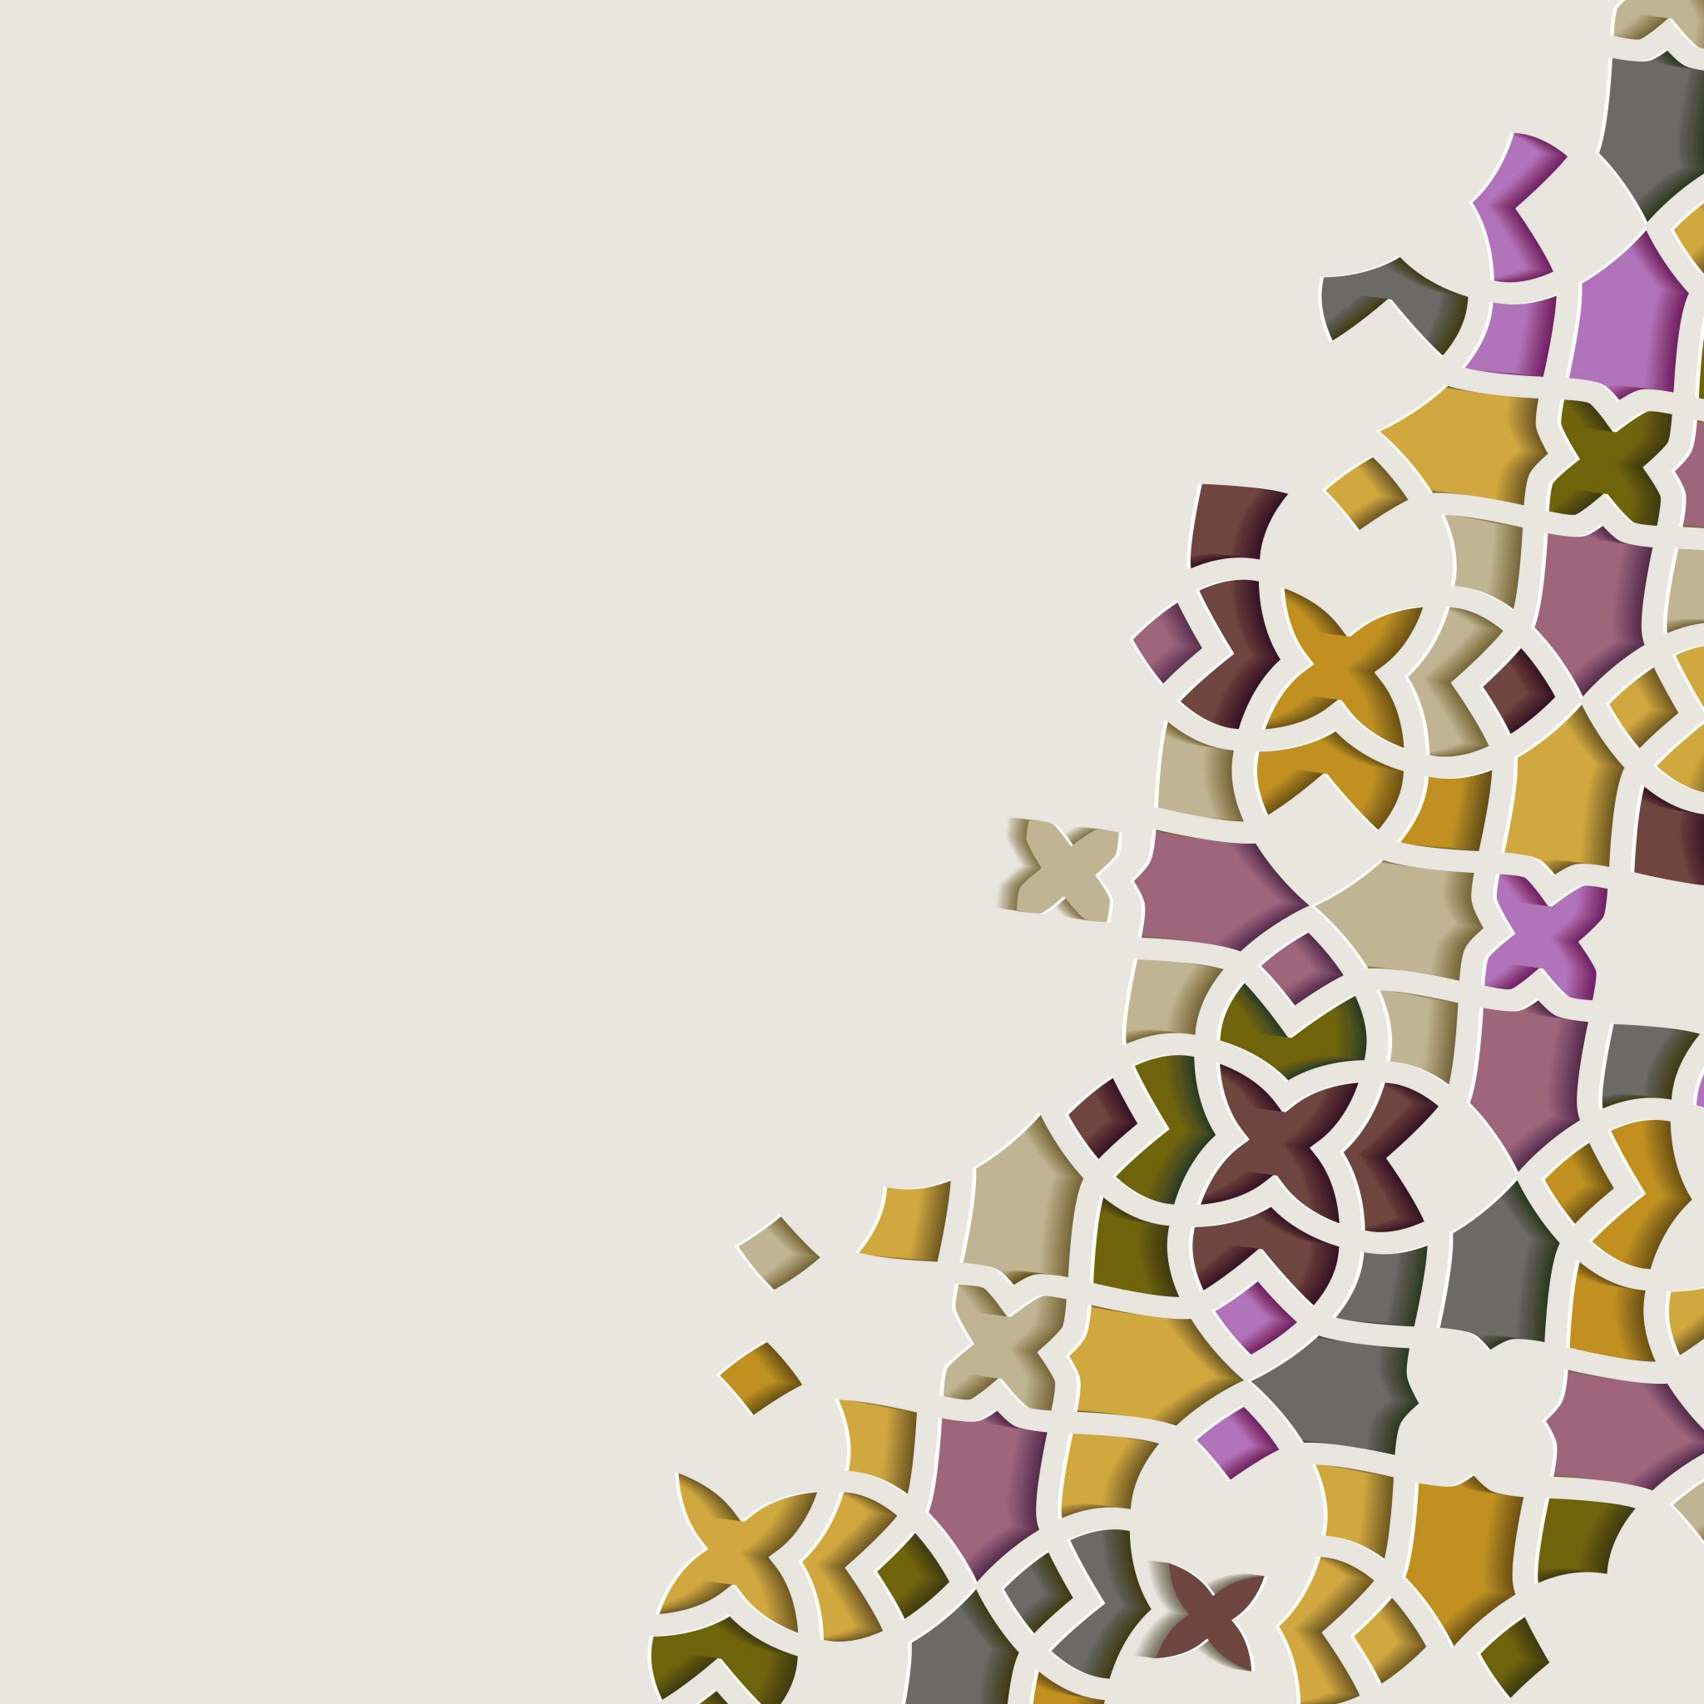
ERASMUS+ KA229 PROJECT
2020-1-PL01-KA229-081615
The craftmanship in our countries

Slide 2
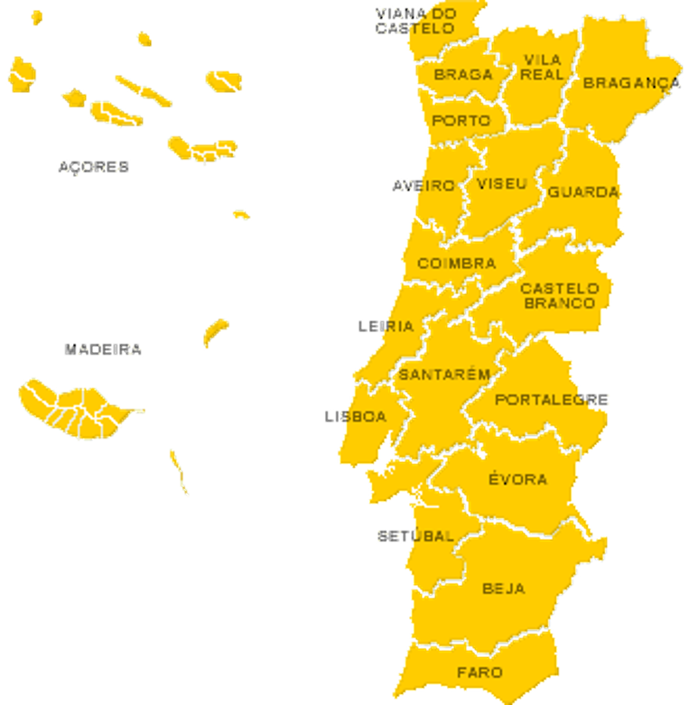
Arts and Crafts IN portugal
The manual production of utilitarian or decorative objects is one of the most appreciated arts in the world. ​
Portugal's handicrafts are very diversified! Many different and unique crafts are in the roots of its people, who proudly try to maintain them. This small country becomes huge when it comes to tradition! ​
Portuguese people are trying hard to maintain these traditions and pass them on from generation to generation.​
Each region excels in its most typical handicraft. ​
We will present a brief journey through the traditional crafts of Portugal, according to the regions that make up our country. ​

Slide 3
Sculpture in
fig tree kernels
Mirandesa Honour’s Cloak
Christmas Crib from Lapinha
Pope
Blankets
Black Clay Pottery from Bisalhães
Ceramics from
Alcobaça
Madeira embroidery
Arraiolos
Tapestry
Villain Boots
Cowbells art
Algarve´s houses and chimneys

Slide 4
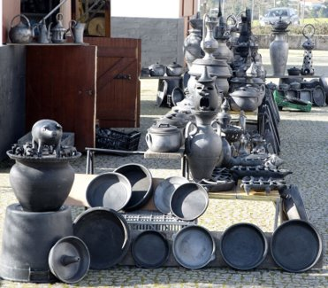
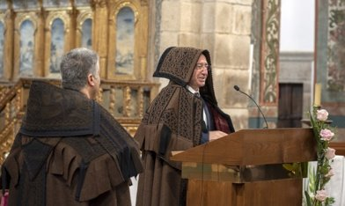
North region
Honour’s Cloak​
typical garment of Miranda region​
used to protect the shepherds in the harshest weather months​
strong symbolic charge and is indispensable nowadays in ceremonies​
it was worn on Sundays by people of great social status​
heaviest, most imposing and oldest Portuguese popular costume​
Black clay pottery from Bisalhães​
Bisalhães in Portugal is known as ‘the land of pot and pan producers’ or more specifically, where black pottery is made​
Stands out for its ancestor processes and techniques used in the making and
baking of this dark type of clay​
dates back at least to the 16th century​
since 2016 has been recognized as UNESCO Intangible Heritage, enabling
the sharing of this Portuguese tradition with the entire world​

Slide 5
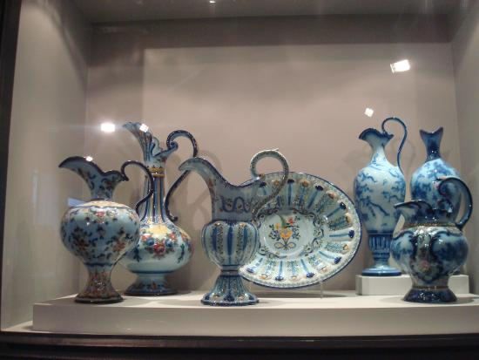
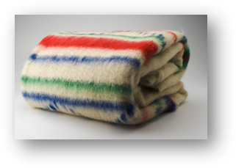
Center region
The Pope Blankets
handmade entirely from wool, extracted from sheep in the region;
The Pope Blanket is a traditional Portuguese handmade blanket characteristic of Serra da Estrela region, the coldest in the country;
These blankets are waterproof, heavy, warm, dense, and fuzzy;
Their traditional use was by shepherds not only to keep them warm but also to scare away wolves whose sight would be confused by all the colours
Ceramics from Alcobaça
The Alcobaça ceramics is known from the north to the south of the country and comes from the center of the country
This pottery is decorated with the colours: yellow, green, violet, red, blue, the latter being the most abundant colour
It is made in several shapes and for different uses

Slide 6
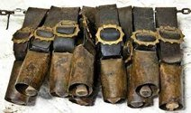
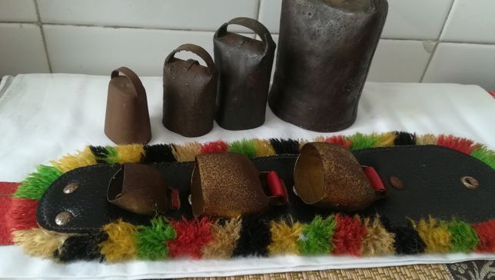
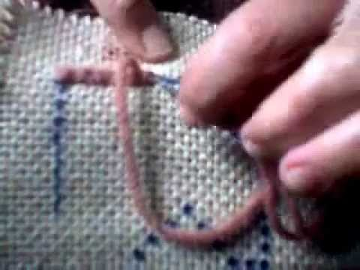
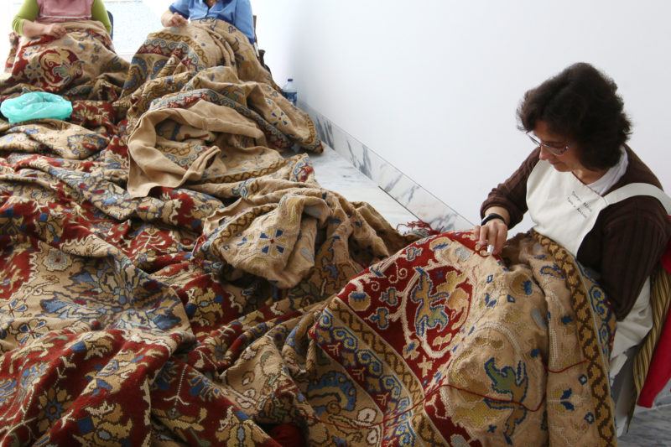
South Region
Arraiolos tapestry
is an embroidered wool rug made traditionally in the small town of Arraiolos;
They are inspired by Persian carpets and made of cotton and pure wool fabric;
The technique of Cross Stitch is used to make them;
They appeared in the XVII century and they are considered important heritage passed on from generation to generation.
Cowbells Art
The manufacture of cowbells, recognised as Intangible Cultural Heritage, is a unique art that has exists in the Alentejo region for over two thousand years;
It started in livestock farming, for shepherds to locate their animals and not let them run away;
It is a traditional percussion instrument with an unmistakable sound which plays an important part in the soundscape of rural areas, especially where animals are still herded;
The craft is passed down from parents to children and requires a very specific manual manufacturing process, before the pieces are polished and given the finishing touches;
This craft remains active in many regions of Alentejo.

Slide 7
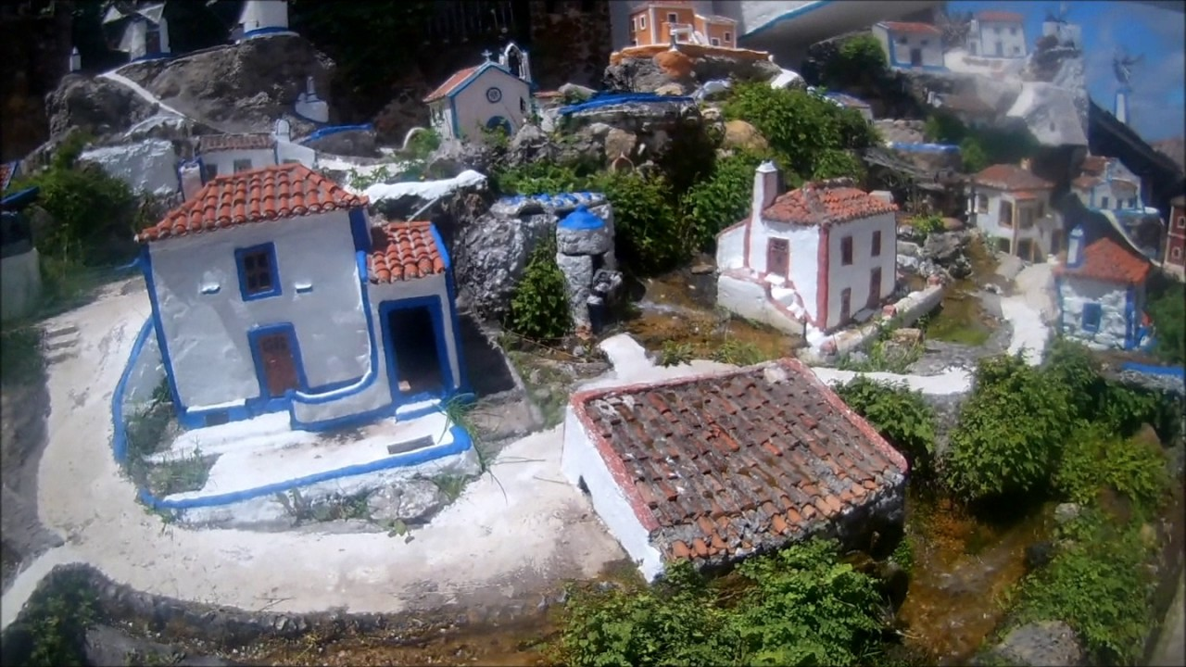
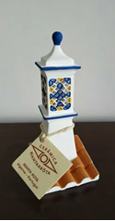
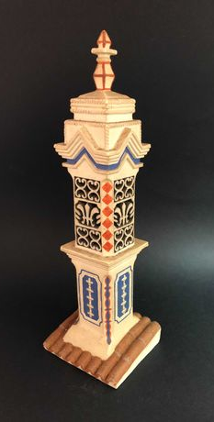
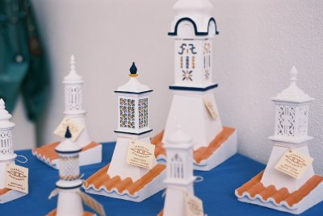
THE Algarve region
Algarve's chimneys
The Algarve's chimneys are a symbol of the region, lacy and meticulous. Each was ordered to be built according to the wealth of the family. The more days it took to make the chimney, the more expensive, bigger and more ornamented it would be.
The predominant colour was the white of the lime, but there are exceptions, especially in ochre and blue. More than pure utility, the chimneys had an ornamental value.
Nowadays you can stroll around the small villages in the Algarve or even in big cities and admire this work of art.
Algarve´s houses
Traditional Algarve architecture reflects the history, popular taste and needs of the people of the south. The whiteness of the walls on the walls, effectively reflecting the sunlight, made the houses cooler.
Typical Algarve houses in miniature, are handpainted, decorated with beautiful details such as chimneys and colorful platibands with geometric motifs.

Slide 8
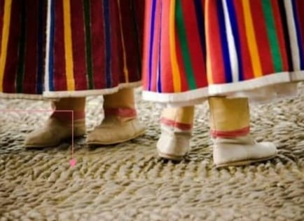
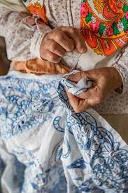
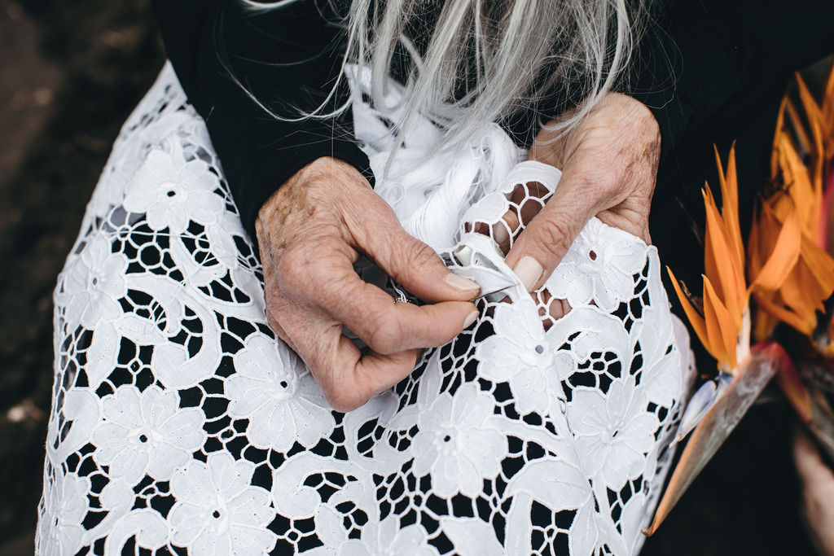
MADEIRA REGION
Madeira Embroidery
Typical from the Madeira archipelago in Portugal dating back to the early days of colonization of the island;
The technique is use on tablecloth, dresses, sheets…
As raw material, it uses fabrics as linen, silk, cotton, and organdy;
And it is believed to have begun to be elaborated by noblewoman as a decoration item, as well as clothing.
Villain Boots
Madeira’s boots originated in the 20th century;
They were used for many decades due to their characteristics: durability, resistance and impermeability;
It is one of most important crafts of Madeira culture;
Currently used only in folk groups handmade by a few manufacturers.

Slide 9
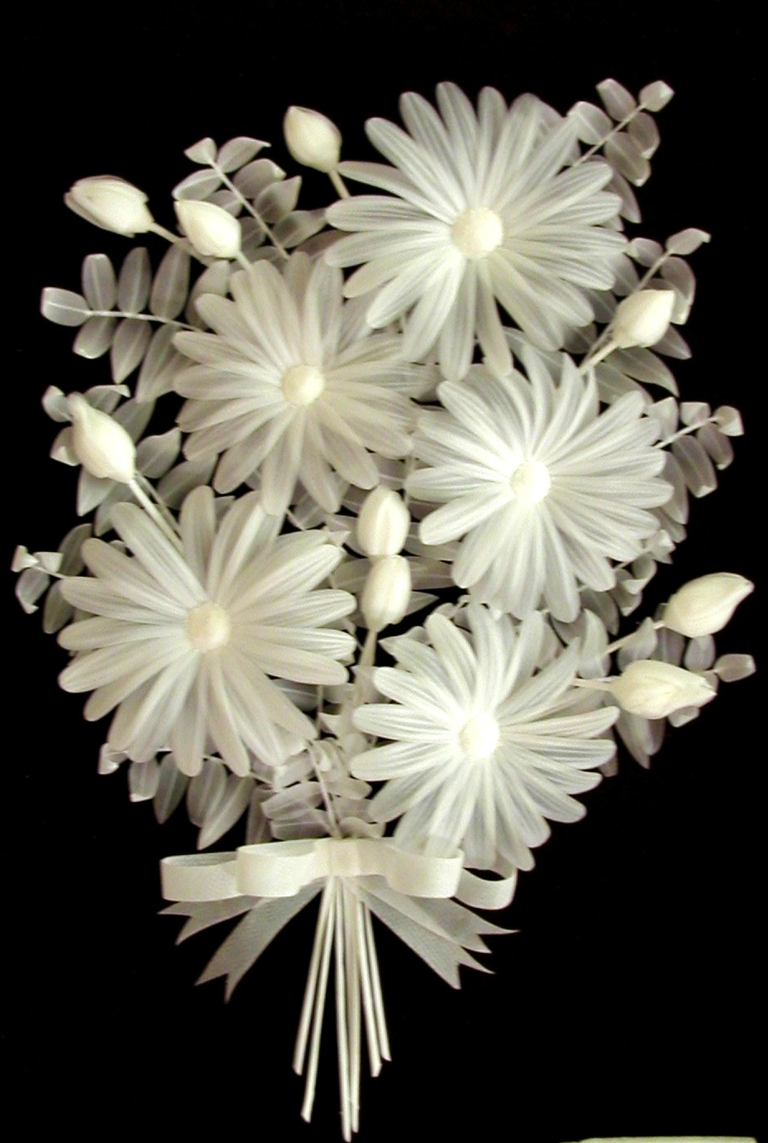
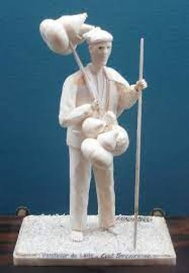
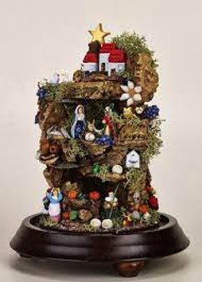
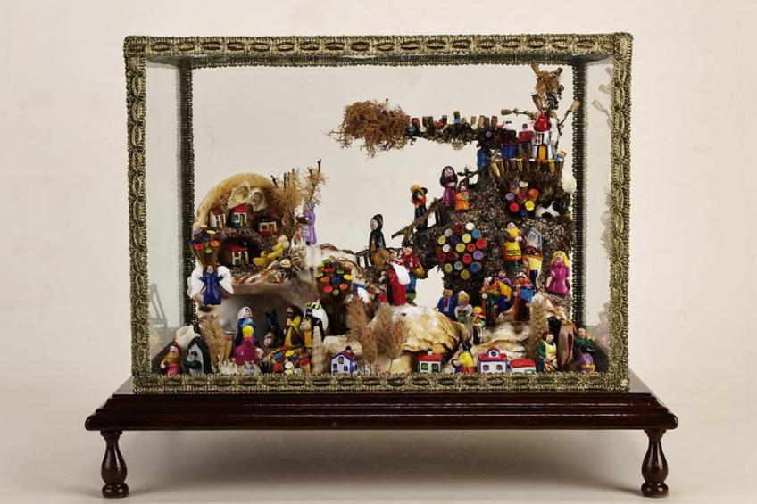
Azores Region
Christmas Crib from Lapinha
They are miniature Christmas cribs, a cultural art from The Azores, especially from the Island of S. Miguel;
They were first created by the hands of nuns in religious convents, in the 16th century;
They were decorated with natural artifacts nuns had available at the time: flowers, shells, fish scales, dried moss, bird feathers, cooton, paper…
The central theme are nativity scenes, the Holy Family and the birth of the Baby Jesus, as well as daily life activities of the time;
As delicate pieces, they are kept inside domes or glass boxes to be exhibited and easily appreciated by everyone.
Sculpture in fig tree kernels
They are small pieces made from the white matter of the core of the branches of the fig tree;
The artisan, with patience and a steady hand, creates beautiful and delicate figures;
It is said to have emerged within the convents of nuns between the 16 and 19 centuries;

Slide 10
"This project has been funded with support from the European Commission. This publication reflects the views only of the author, and the Commission cannot be held responsible for any use which may be made of the information contained therein."
ERASMUS+ KA229 PROJECT 2020-1-PL01-KA229-081615

