Slide 1
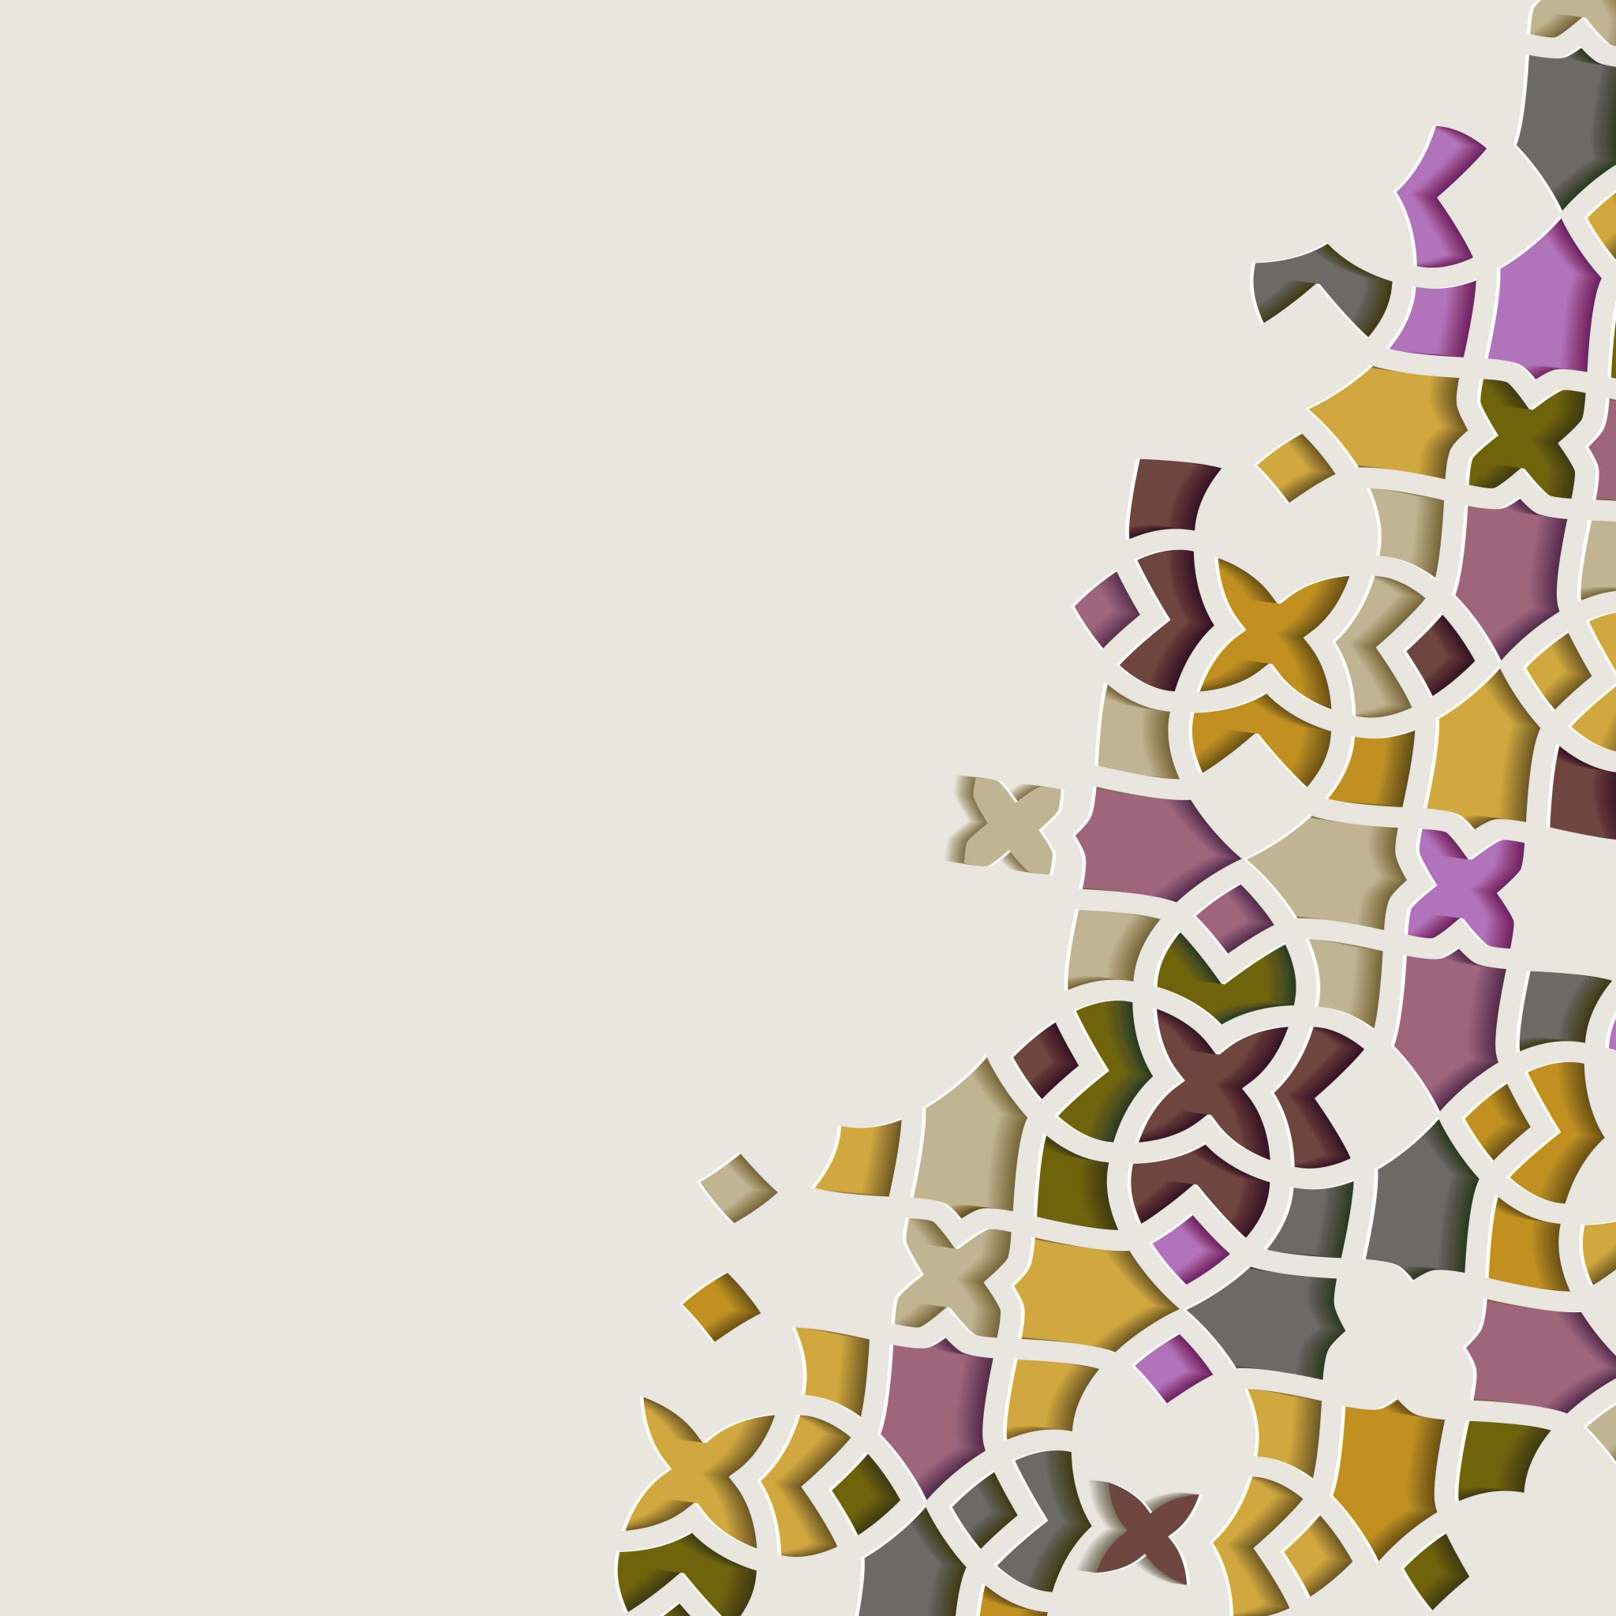
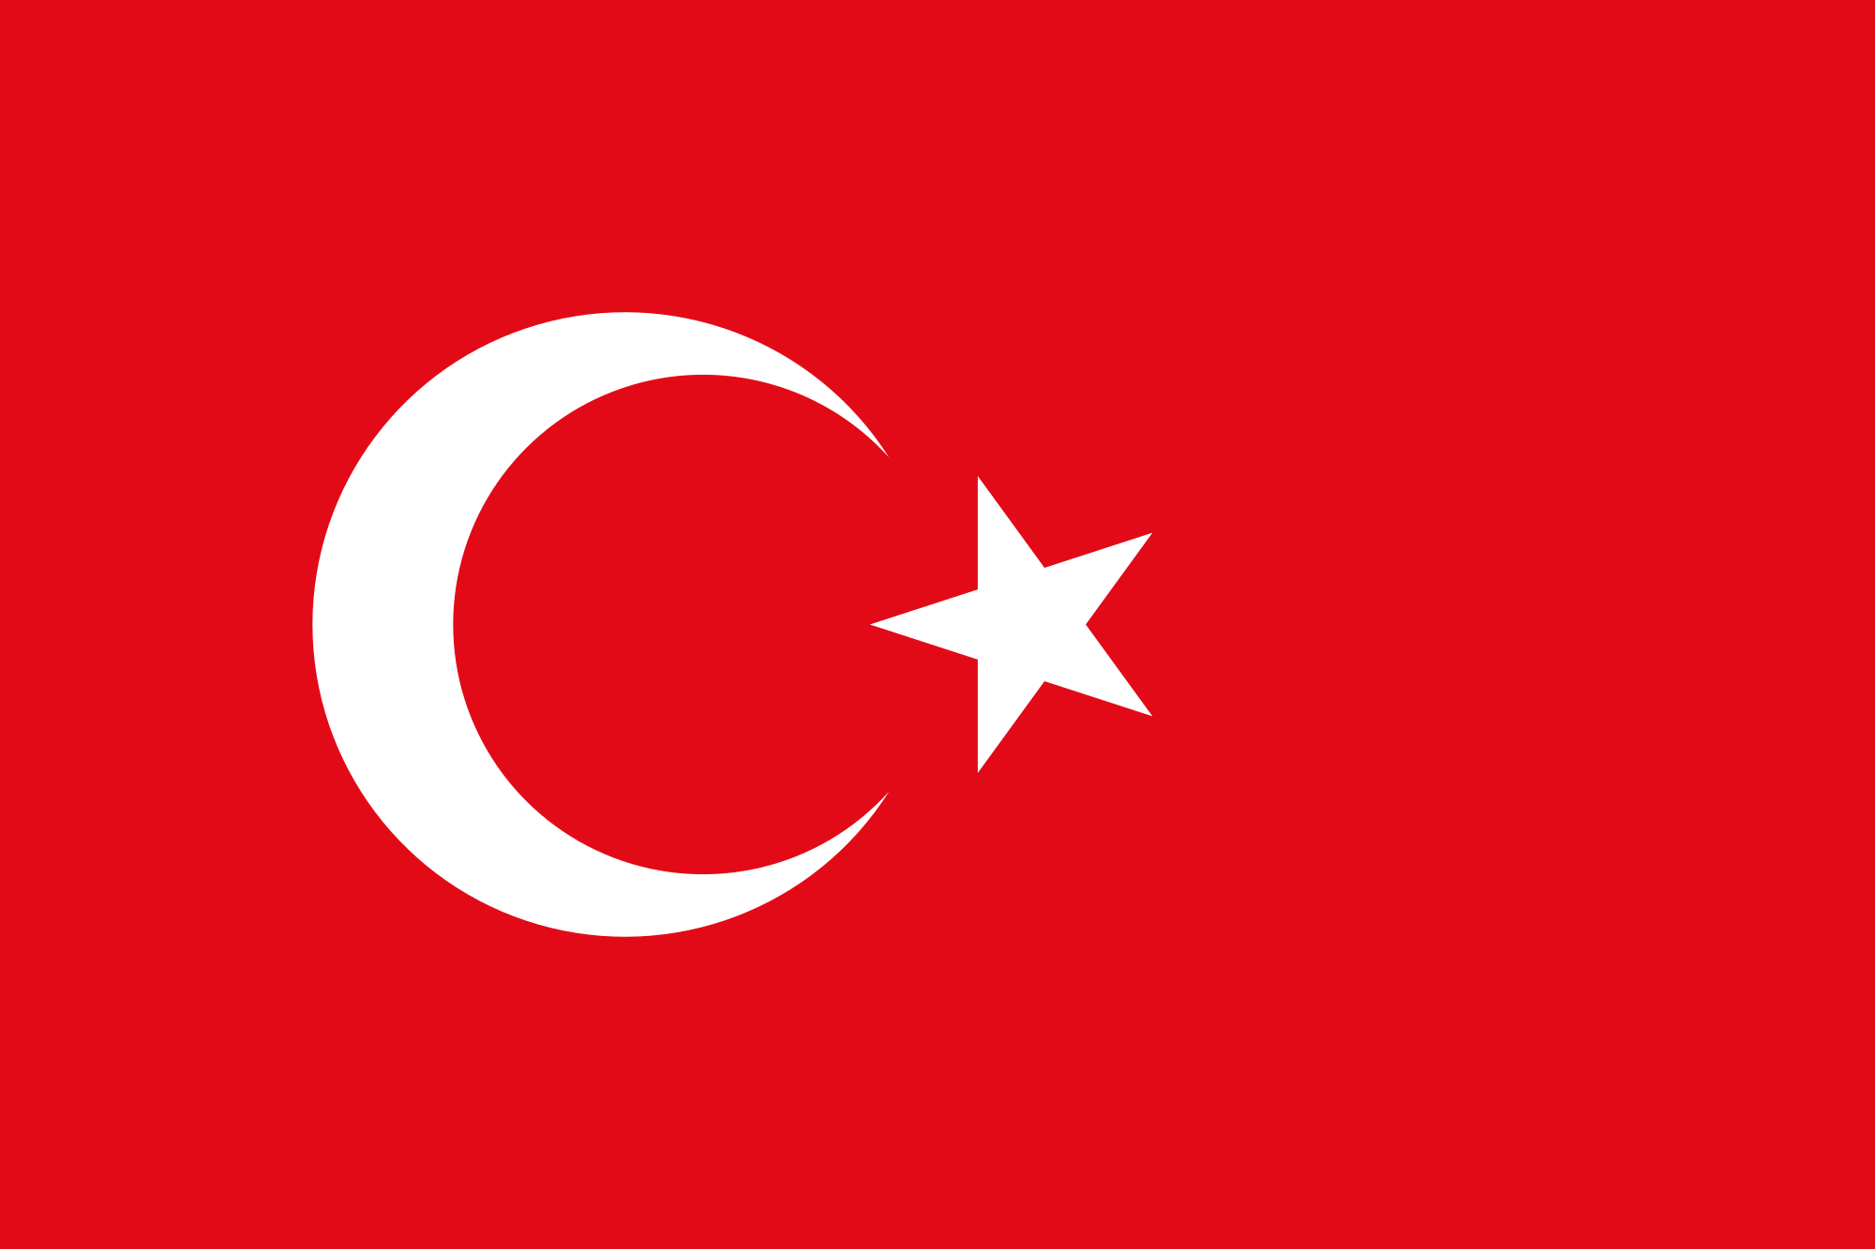
ERASMUS+ KA229 PROJECT
2020-1-PL01-KA229-081615
THE CRAFTMANSHIP IN OUR COUNTRIES
TURKEY

Slide 2
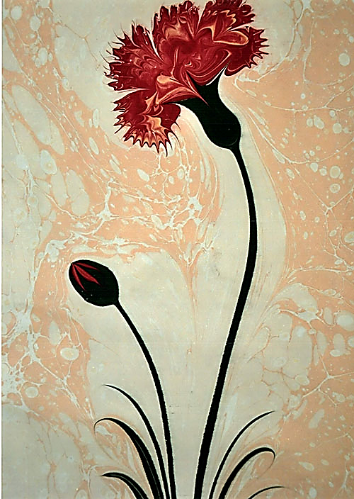
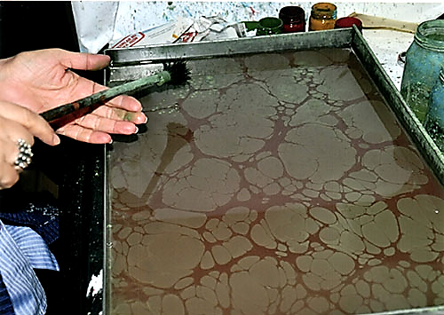
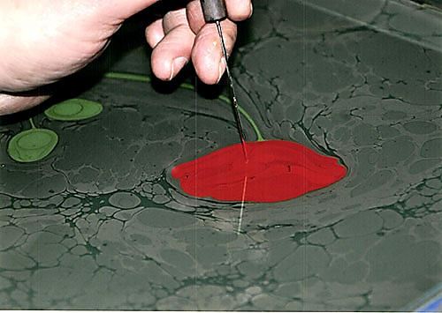
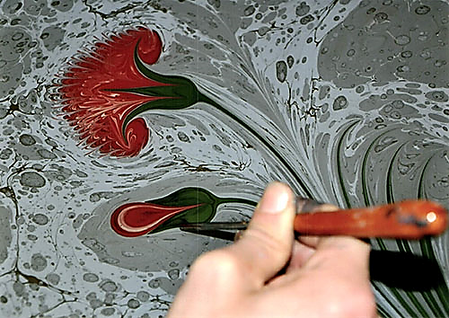
MARBLING
Known as «marbling», Ebru is the traditional Turkish art.
Initially creating colourful patterns by sprikling and brushing colour pigments onto a pan of oily water. The process is repeated until the surface of the water is covered with unique patterns like flower designs, circles etc. Then transferring the pattens to paper. As a result, we have gorgeous artwork.
In 2014 Ebru art inscribed in the UNESCO’s list of Representative List of the Intangible Cultural Heritage of Humanity.

Slide 3
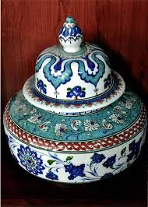
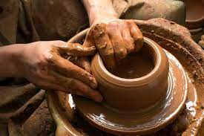
POTTERY
Pottery is one of the handcrafts that has been made in Anatolia since ancient times. Mud is the oldest and most useful of easily obtained raw materials. While it’s soft, it can be shaped without breaking. Basic methods applied in making pottery by hand; pinch, wick, plate, pattern. The cored mud is poured into molds of various sizes, by hand or by passing it through a potter's wheel, to give form. Earthenware pots, pots, jugs, vases, jars, etc., made by firing in ovens, glazed or not. can be defined as the art of making.
The pots produced in Anatolia are usually glazed with diluted mud, and the pots are fired on an open fire. Today, the art of pottery, which has begun to lose its functional structure, but is evaluated in its usage areas, continues with a small number of masters in a few regions.

Slide 4
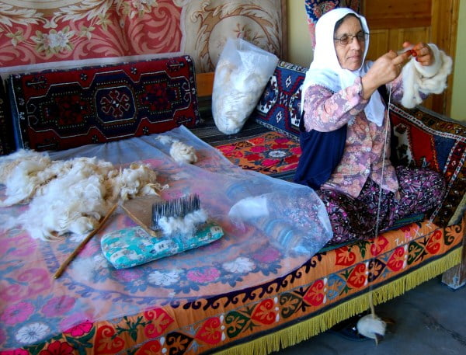
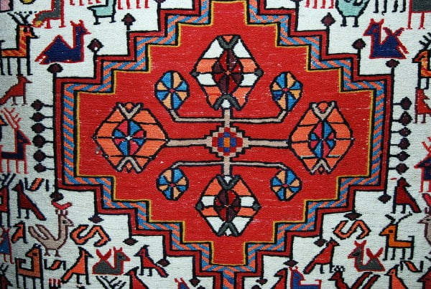
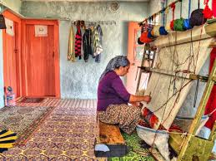
CARPET WEAVING
Turkish carpets have a worldwide reputation for excellence and are a specialist product of which many people whether educated in the history or not, can apperiate.
Despite industrialization, Turkish carpet weaving has survived to the present day.
PROCESS OF MAKİNG TURKISH CARPETS;
Firstly collecting the wool to prepare it for the color process (Emphasis is on using natural dyes maintaing the colour of a carpet over the years). When the wool is ready, it is rolled into balls and placed at the top of a frame. Then the women set to work weaving the wool in and out. A pattern is also at the top of frame and when a section is completed, it is trimmed down with a pair of scissors.
Using this process, A Turkish carpet can take months and even years to make.
One of the reason that Turkish carpets are specialist prouduct ıs, patterns have meanings. For instance the eagle symbolizes power, scorpion symbolizes evil soul, buck symbolizes heroism.

Slide 5
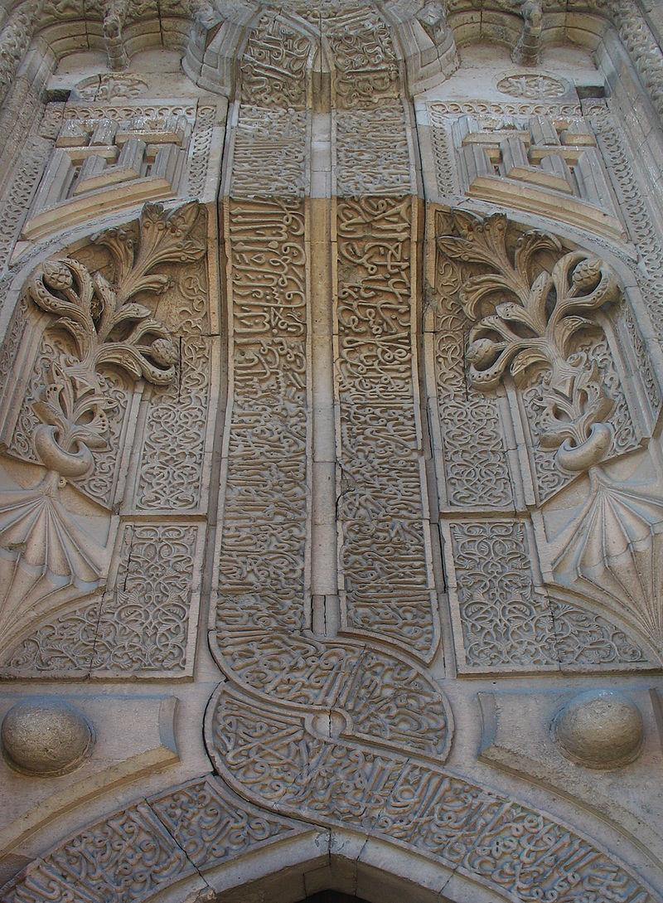
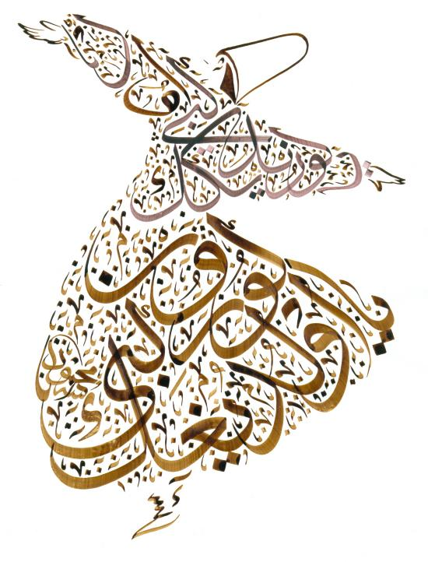
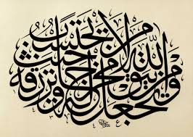
HUSN-I HAT
The HÜSN-İ HAT is the centuries old pratice of writing letters of Arabic origin. In a measured and proportional manner while taking into consideration certain aesthetic values.
Many calligraphers make their own tools and they play an important role in the transmission of the Hüsn-i Hat tradition, passing on their knowledge, craft skills and values through apprenticeships.
The Hüsn-i Hat can be written on paper. To this day, Hüsn-i Hat is still used in sacred and literary works like mosques and traditional Turkish baths.

Slide 6
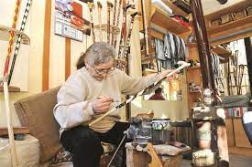
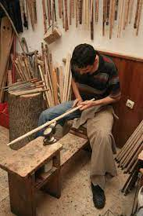
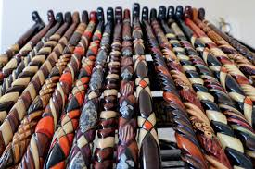
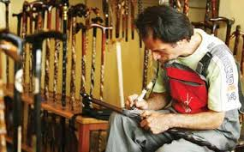
DEVREK WALKING STICK
Craftsmen from Devrek who had improved themselves in the art of wood worked in the cerpentry shop of the Ottoman Palace.
The tree which is the main material of the stick is abundant in the Western Black Sea Region which has a forested vegetation.
The Classic Devrek Walking Stick is completely handcrafted. Its body is cranberry, its stem is walnut and there are usually two snake motifs on its body, their heads entwined towards the stem.Today, handles made of different shapes and materials and walking sticks with paint, silver, mother-of-pearl and copper embroidered motifs are produced.
The most important feature that distinguishes the Devrek walking stick from other walking sticks is that the cane and the handle of the cane are made of different materials.There are snake, eagle head, goat's feet, baklava slice symbols on Devrek walking stick.

Slide 7
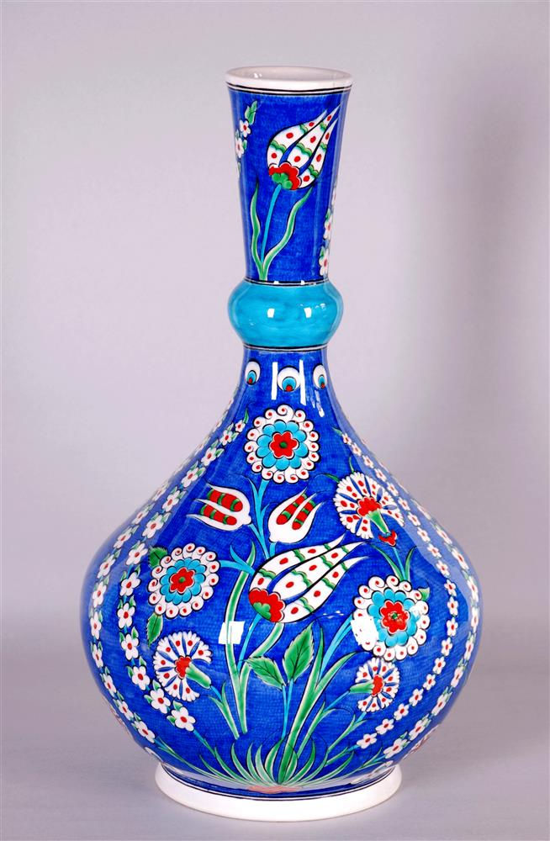
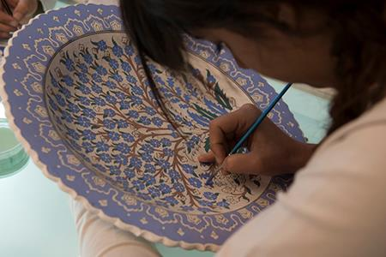
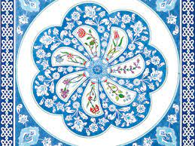
ÇİNİ MAKING
Çini-making means the craftsmanship shaped around traditional Turkish art of çini since 12th century with its own specific production.Having shaped, the clay is lined and dried. Next, it is fired in çini ovens and smooth surface called “biscuit” appears. Patterns prepared by drilling on the paper with openwork technique are transformed to the surface with coal dust and the outer contours are drawn by hand with black paint and brush. Later, patterns are dyed with various colours. The surface of çini is covered with glaze and after it is fired at the çini-making is completed.
Among çini adornments generally geometric shapes, plants and animal figures symbolizing cosmic thoughts and beliefs are used in different colours. Using red, cobalt blue, turquoise and green on white or navy blue background is the characteristic feature of traditional çini’s. Bearers and practitioners of the element are çini craftspeople. It’s estimated that more than 5000 çini craftspeople exist in Turkey.
Ethical manners, knowledge, techniques, prescriptions and rituals of çini-making developed collectively throughout centuries have been conveyed to the present through master-apprentice/parent-child relations. Çini workshops which have been still operating since 14th century especially in Kütahya are well-known cultural spaces to maintain the common memory about the element.

Slide 8
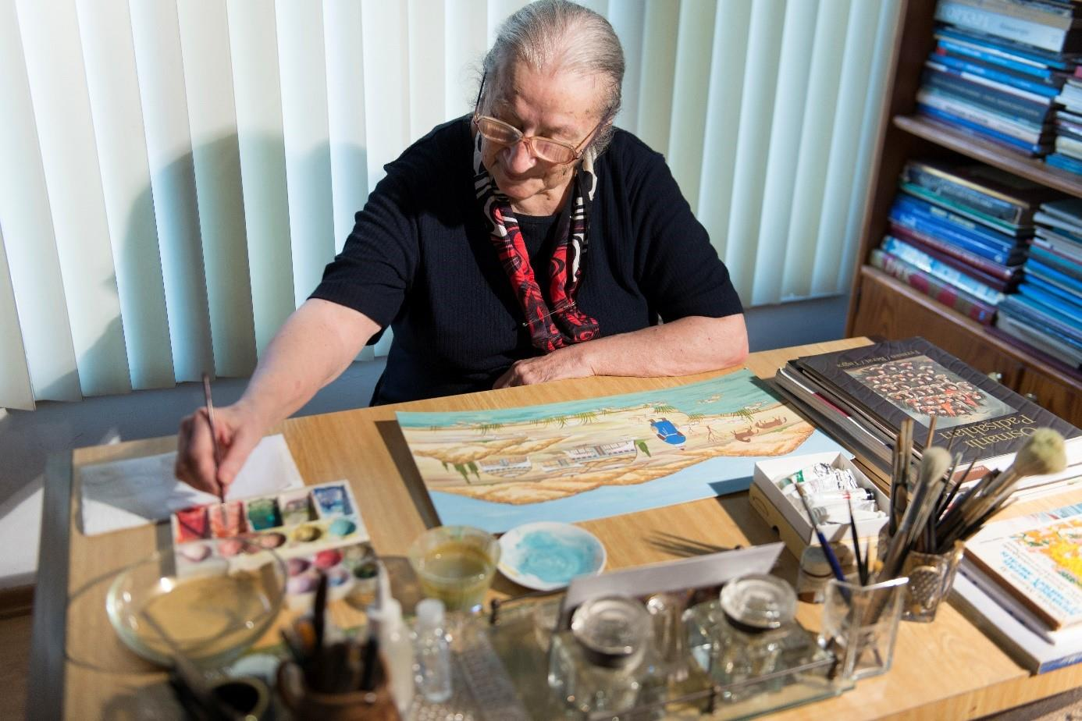
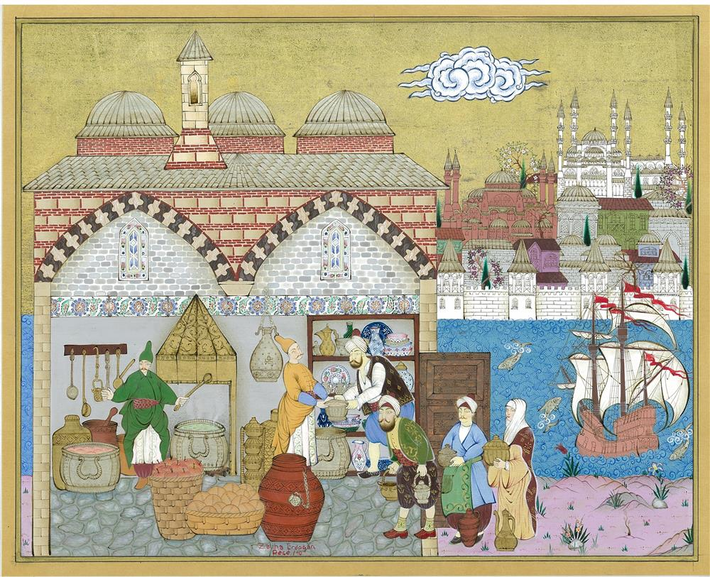
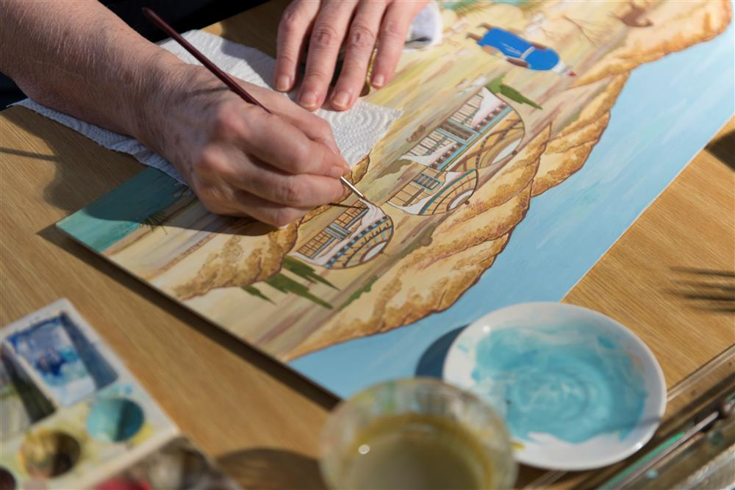
MINIATURE
Miniature is the art of illustrating stories, events or knowledge by a method of painting.
Beginning from the 19th century, the areas where this art is applied has diversified and, in addition to books, miniatures have been applied more onto the materials like walls, canvas, wood, tile and leather. Mostly used equipment are organic dyes and thin brushes made of bird feathers. Today, industrial dyes and equipment are also used.
Landscapes, ceremonies at palace like accession, circumcision, wedding and hunting scenes are depicted as the dominant subjects of miniatures. Miniatures give information about the daily life, clothes and rituals of the era. Therefore, they also function as a historical document.

Slide 9
"THIS PROJECT HAS BEEN FUNDED WITH SUPPORT FROM THE EUROPEAN COMMISSION. THIS PUBLICATION REFLECTS THE VIEWS ONLY OF THE AUTHOR, AND THE COMMISSION CANNOT BE HELD RESPONSIBLE FOR ANY USE WHICH MAY BE MADE OF THE INFORMATION CONTAINED THEREIN."
ERASMUS+ KA229 PROJECT 2020-1-PL01-KA229-081615

