Slide 1
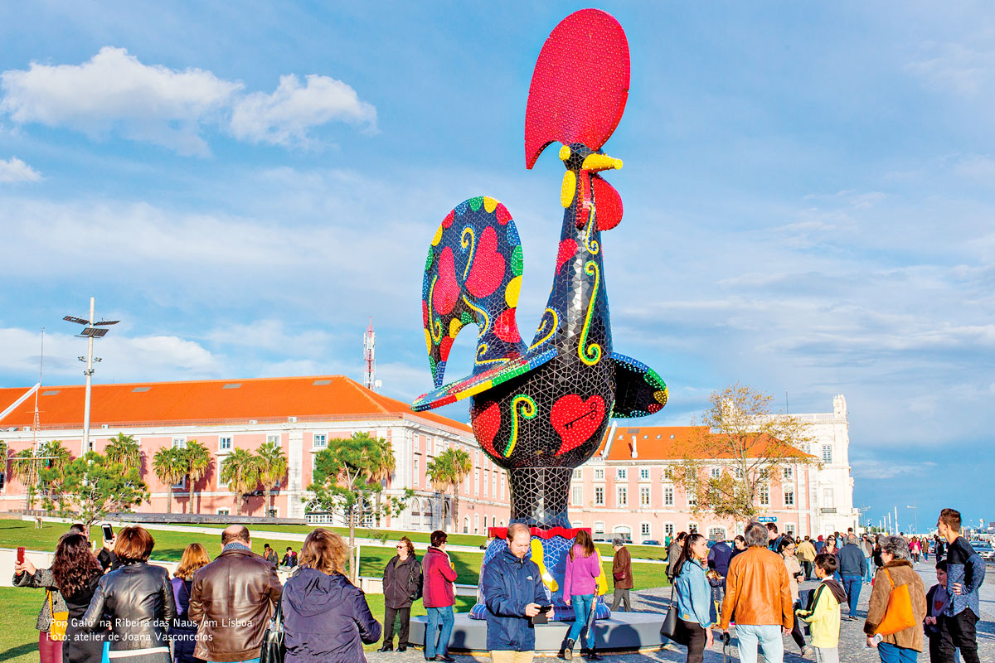
THE LEGEND OF THE Barcelos ROOSTER

Slide 2
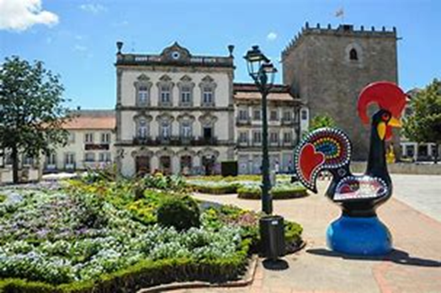
Barcelos
The legend takes place in the 15th century, in Barcelos, which is an important part of the pathway of the Pilgrimage to Santiago de Compostela.

Slide 3
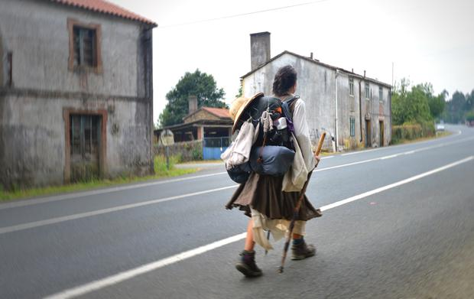
The legend of the Barcelos Rooster
Local inhabitants were very upset by an unsolved crime so terrible that it had people scared to leave their houses.
Around that time, a very poor and scruffy pilgrim was passing through Barcelos in order to fulfil a promise.
As nobody knew him, they gathered he was
the assassin and he was arrested and condemned
to hang.

Slide 4
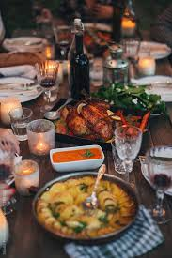
The legend of the Barcelos Rooster
The pilgrim refused to go quietly and asked to be taken to the judge who sentenced him to death.
The authorities granted his wish and brought him to the magistrate’s house who was having a banquet with friends.
The pilgrim swore his innocence and pointed to a roasted rooster on the table and said: "As surely as I am innocent will that Cockerel crow if I am hanged"

Slide 5
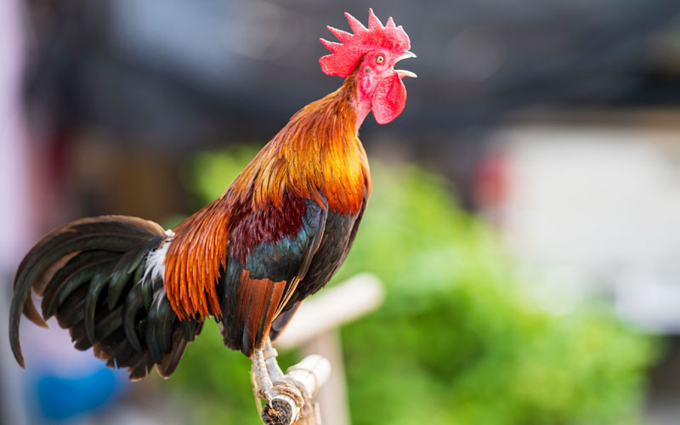
The legend of the Barcelos Rooster
Obviously, they all laughed and the judge ignored the pilgrim’s statement of innocence, but still dropped the rooster in the trash bin as he had lost his appetite.
The following day, when the time came, the pilgrim went to the gallows to accept his punishment but, right before the executioner could hang him, the roasted rooster appeared at the window, stood in front of the crowd and crowed just as the pilgrim had predicted.

Slide 6
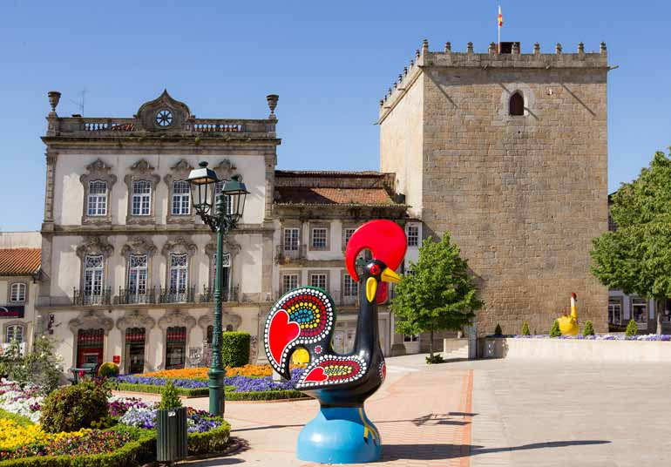
The legend of the Barcelos Rooster
The judge realized the mistake he had made and rushed to save the pilgrim and he didn’t hang. Instead, he carried on his path to Santiago de Compostela in order to fulfil his promise.
Years later, he returned to the town and built the monument to São Tiago and to the Virgin.
And the rooster became the city symbol!

Slide 7
Moral of the story
We must believe the truth and not judge without strong evidence.
Only then you will be able to defend your honor and dignity.

Slide 8
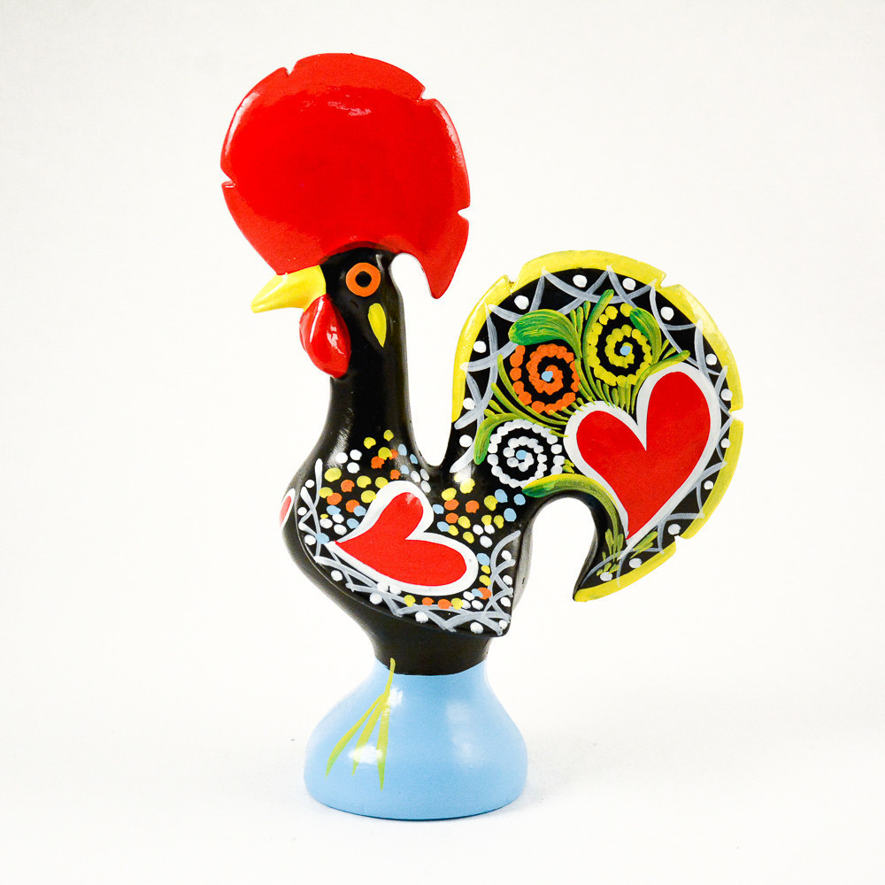
What does the rooster symbolize ?
faith,
honesty,
justice,
and good luck
It is said that anyone who has a Barcelos Rooster in their home will attract good fortune and happiness.

