Slide 1
ART AND INTERCULTURAL DIALOGUE
ERASMUS+ KA229 PROJECT
2020-1-PL01-KA229-081615_4

Slide 2
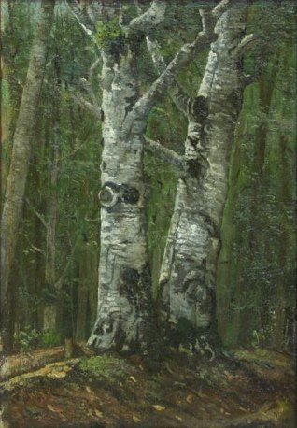
Painting
Landscapes, static nature, the Romanian village, and other subjects are shown in the paintings. They show Romanian creative talent, the constant approach between traditionalism and innovation, with each painter stamping his or her imprint on the way the theme is interpreted, on color, light and shadows, and on the artistic language in general.
The presentation of the reality as a whole, of the painter's experiences, thoughts and feelings is the main characteristic of all the works .
The existence of an ancient Byzantine tradition was proved by the flourishing of mural painting in Wallachia in the 14th century. a model for mural painters from the Romanian Lands and Transylvania, integrated in a real painting school.
Grigorescu's portraits of peasants, full of effusion and youthful pride, are remarkable, Andreescu's vocation for landscapes breathes an air of sobriety and meditation, while Luchian adds a tragic intensity to the delicacy and grace of his flowers, which brought him a great reputation.
In the next 3 slides we will present to you Grigorescu, Andreescu and Luchian mentioned above.

Slide 3
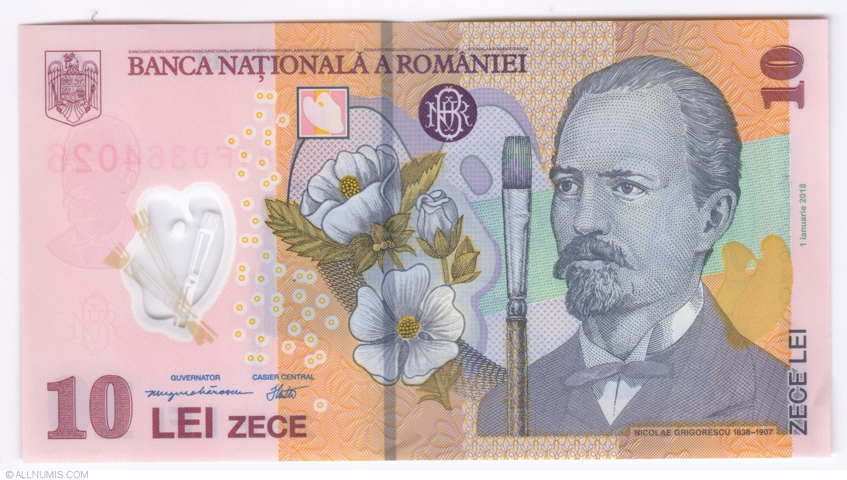
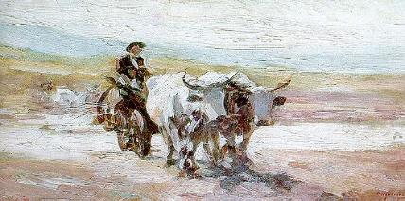
Nicolae Grigorescu
Nicolae Grigorescu (15 May 1838 – 21 July 1907) was one of the founders of modern Romanian painting. Nicolae Grigorescu became a symbol for the young generations of artists who, in the first decades of the twentieth century, sought to identify and bring to light the values of Romanian spirituality. In the autumn of 1861, young Grigorescu left for Paris, where he studied at the École des Beaux-Arts. He also attended the workshop of Sébastien Cornu, where he had as a colleague Pierre-Auguste Renoir. He returned to Romania a few times and starting in 1870 he participated in the exhibits of living artists and those organized by the Society of the Friends of the Belle-Arts.
Between 1873 and 1874 he traveled to Italy, Greece and Vienna.
Romanian currency features Grigorescu on the 10 Lei bank note.
The work "Car with oxen“(Carul cu boi), made in 1897, when Grigorescu was already in full artistic maturity. The painting was originally designed for a spectator who should look at it from a distance: touches that alternate in size, pressed where the color is accentuated, suggest the materiality of a landscape specific to the rural world of our ancestors. The long horizontals of the landscape correspond to the short verticals of the ox carts, the composition being thus as balanced as possible from a dynamic point of view.

Slide 4
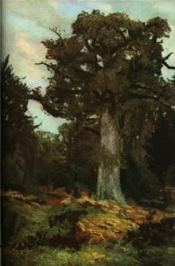
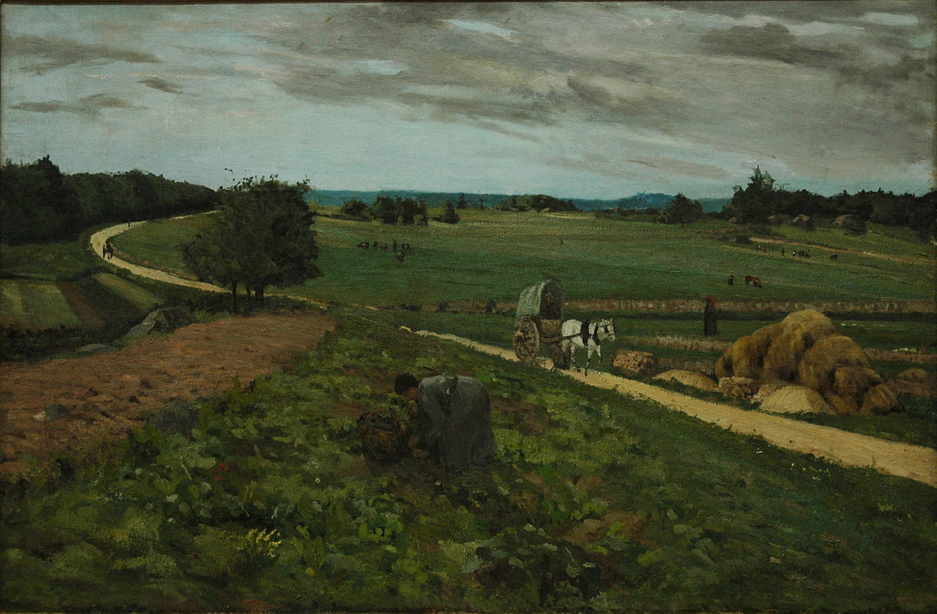
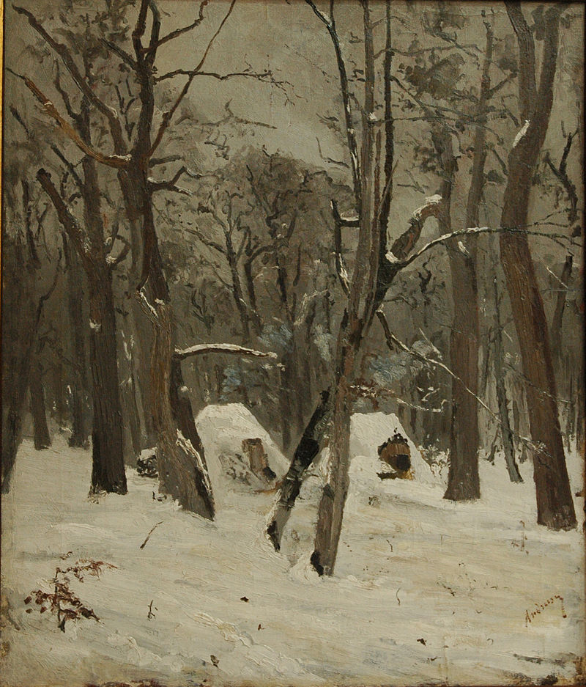
ION ANDREESCU (1850-1882)
He was the son of Andrei Dobrescu and Anastasia Pencovico. It is unknown if he was born in Bucharest or in another one of his parent's residences in the vicinity of the city. His father was a beverage merchant and owned an Inn in Mahalaua Staicului.
In “The Oak”, one of his masterpieces, we can see his melancholy. The painting is dominated by the tree, in contrast with solid green colors and the depth of the sky, in the background.
The oak (Stejar)
The main road (Strada principala)
The winter (Iarna)

Slide 5
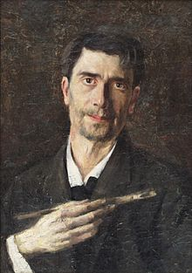
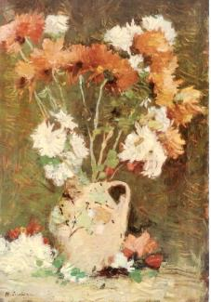
Ștefan Luchian(1868-1916)
Luchian was born in Ștefănești, a village of Botoșani County, as the son of Major Dumitru Luchian and of Elena Chiriacescu. He moved to Bucharest in 1873 and his mother desired that he would follow his father's path and join the Military School. Instead, in 1885, Luchian joined the painting class at the Fine Arts School, where he was encouraged to pursue a career in art by Nicolae Grigorescu, whose work was to have a major effect on his entire creative life.
Luchian adds a tragic intensity to the delicacy and grace of his flowers, which brought him a great reputation.
Anemona Flowers(Anemone)
Chrysanthemums(Crizanteme)

Slide 6
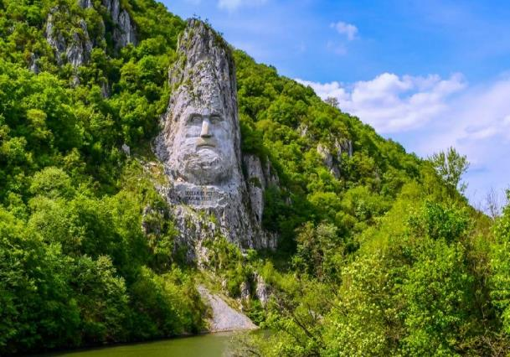
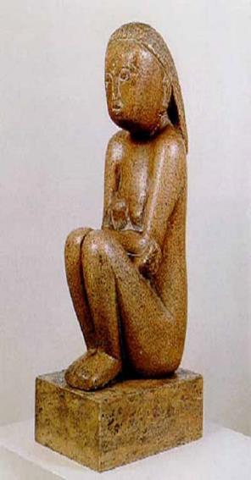
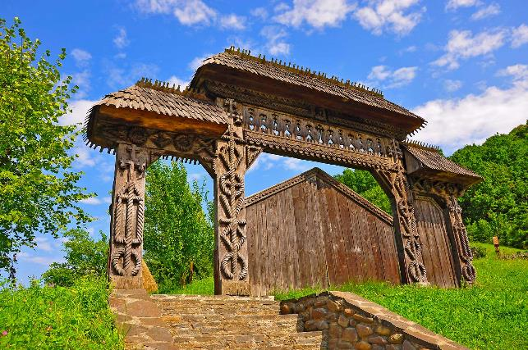
Sculpture
Since ancient times, people have processed stone. First for buildings, then the wheel was invented, and so on. But the people didn't developed just the technic. They have also evolved mentally or spiritually.
The proof is the masterpieces we have today.
In our country, sculpture has always been a human occupation .In stone or wood, Romanian sculptors are known worldwide for their talent, dedication and skills .

Slide 7
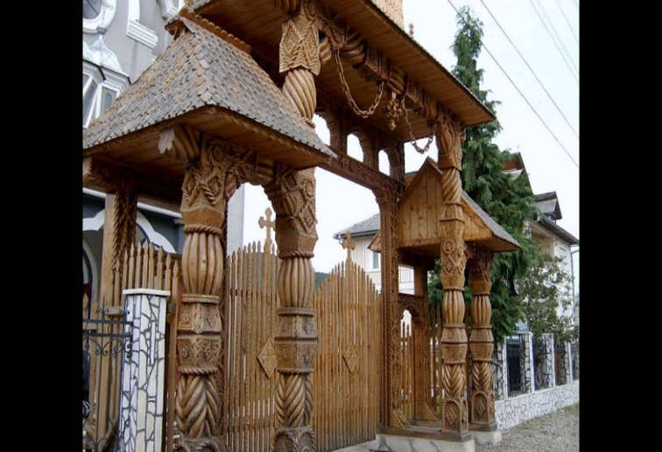
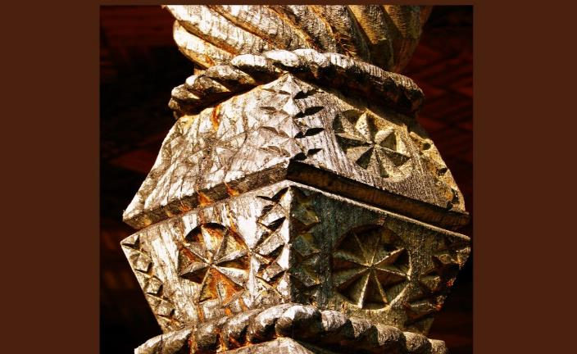
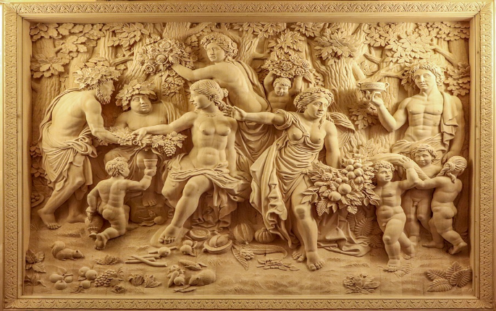
Wooden Gates in Maramures
The gate connects with the world beyond the village, with the safe world, hidden from all that is bad and what can affect those in the house. Not everyone had the right to build a gate, but only the "unmarried" peasants, of rank, descendants of the princes and the proof that this land is full of people of noble village cattle is the impressive number of old gates on the river valleys mentioned above. The gate was a sign of the wealth and pride of the Maramures man's house, protecting the house, the household and the animals, being a model of ancient craftsmanship that continues today.
It is no coincidence that the Maramures gates have carved motifs full of deep meanings, many of them pre-Christian, such as the sun - represented as life, the tree of life symbol of growth, the snake as the guardian of the household, the wolf tooth symbolizing power and of course apotropaic significance. Rosettes of different sizes and coils, symbols of genesis, of the beginnings of the world, of perfection, are present on every gate, even those erected today, as a proof of the continuity of faith in the values ​​grounded for centuries.
In fact, Wood carving has an old tradition and as with other art forms besides the tools, materials, and techniques used it takes creativity and passion to give birth to valuable works of art.

Slide 8
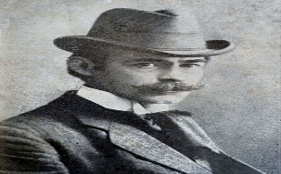
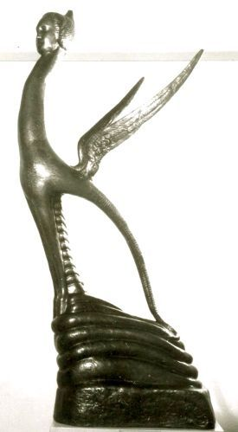
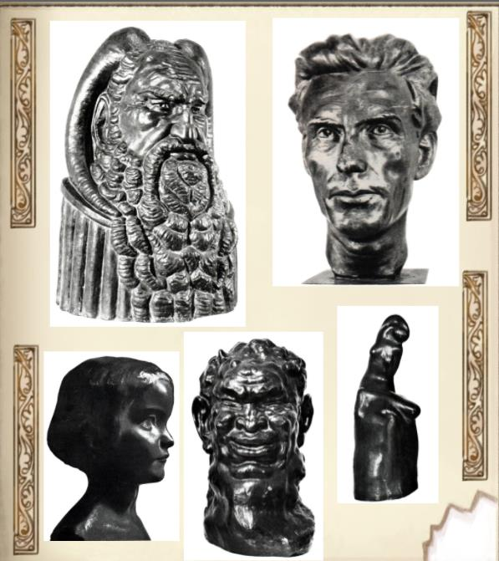
Famous Romanian Sculptors and Sculptures
The chimera of the air is a figurative, symbolic and fantastic composition that represents a human figure. A star was modeled on his forehead, initially it was a model for Mihai Eminescu, to illustrate the poem Luceafărul. It has a long neck, sharp wings, goat legs, snake tail, layered base. Present at the official salon in 1927 when she was awarded the national prize for sculpture. A fragment of the wing is in the permanent exhibition of the national gallery.
Dimitrie Paciurea was a Romanian sculptor, graphic artist, water colourist and professor. He made numerous portraits and several monumental projects and was the creator of new forms in sculpture and drawing, thus becoming a first-rate personality and without equivalent in local and European art. The series of Chimeras that he made since 1920, are the works that dominate the entire creation of the Romanian sculptor.

Slide 9
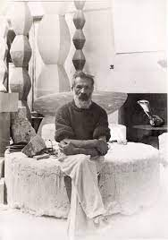
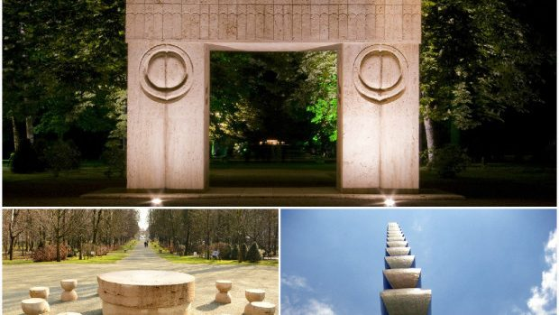
Constantin Brâncuși (1876-1957), one of the greatest sculptors in the world.
Constantin Brâncuși was a Romanian sculptor with overwhelming contributions to the renewal of language and plastic vision in contemporary sculpture. Constantin Brâncuși was elected posthumous member of the Romanian Academy. Brâncuși freed the sculpture from the preponderance of the mechanical imitation of nature, he refused the figurative representation of reality, he expected the expression of the essence of things, of the vitality of form, he created the unity between the sensible and the spiritual. In his work he mirrored the way of thinking of the world of the Romanian peasant..
The Sculptural Ensemble of Constantin Brâncuși at Târgu Jiu is an homage to the Romanian heroes of the First World War. The ensemble comprises three sculptures: “The Table of Silence” , “The Gate of the Kis” and “ the Endless Column “. The ensemble is considered to be one of the great works of 20th-century outdoor sculpture.
“Sleeping Muse” (Muza Adormita), Brâncuși’s most expensive sculpture.

Slide 10
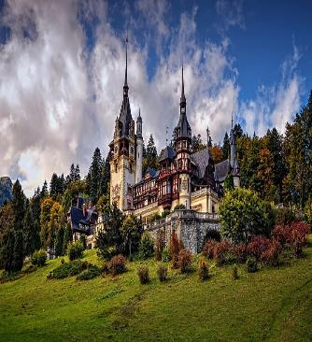
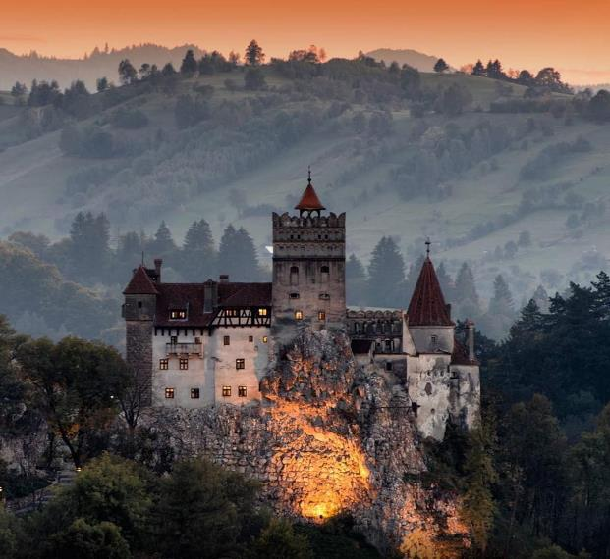
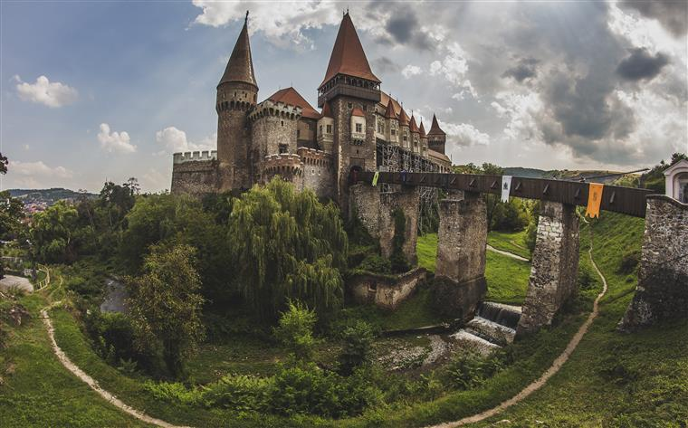
Architecture
The history of architecture in Romania starts with the very first buildings and structures on the territory of our country, from the period of the Dacian civilization, to which were later added the innovations of Roman technology. During the Middle Ages, the art and technique of churches evolves in parallel with the art and technique of castles and palaces in a diversity of Romanian styles for it to change in the modern era when European styles with large buildings and structures are used.
Three of the most beautiful castles in Romania, in this order: “Peles Castle (Castelul Peles)”, summer residence for the former Romanian Kings, “Bran Castle (Castelul Bran)” , famous for the legend of Dracula, and “Huniazilor Castle (Castelul Huniazilor)” , which seems to come from a fairy tale…

Slide 11
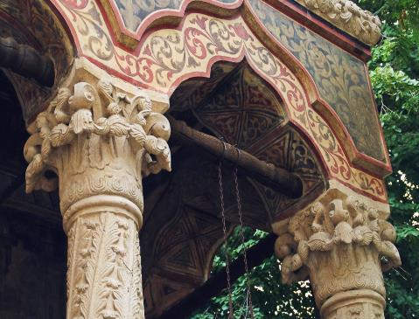
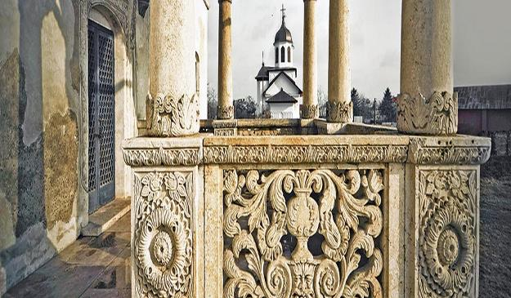
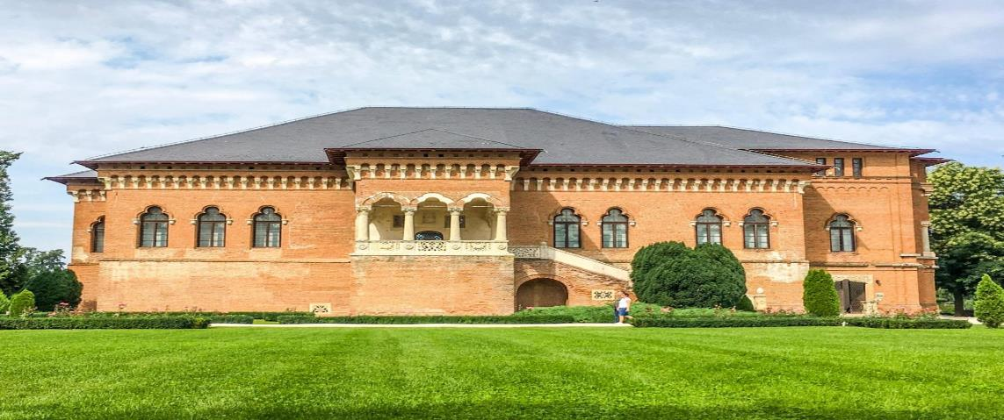
Brancovenesc style - the first Romanian style of architecture
The Brancovenesc style represents a syncretism between local artistic traditions, Wallachian, Byzantine and other oriental influences and western forms of the Renaissance, such as the Italian school.
The architectural style of Brancoveanu is recognized today as being "the first Romanian style". The main characteristics of the style are: the elements of artistically processed stonework; the relief accentuated by the "a jour“ technique both in the stone carving and in the artistic processing of the wood, the vegetal motifs predominate: acanthus, twigs, grapes, sunflower
Art historians sometimes characterize the style by analogy with the Western Renaissance, due to its clear, rationalist structures, but its decorative exuberance also allows the use of the term Brancoveanu Baroque.

Slide 12
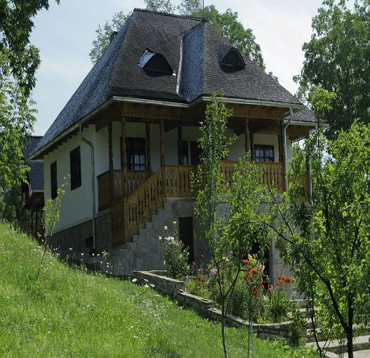
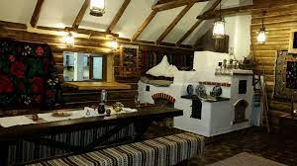
The Romanian Traditional House
Characteristic for the Romanian traditional house is the porch, placed in the facade of the house. The porch is a shelter, but also a work place.It has a very important role in the aesthetic of the house,being beautiful decorated.

Slide 13
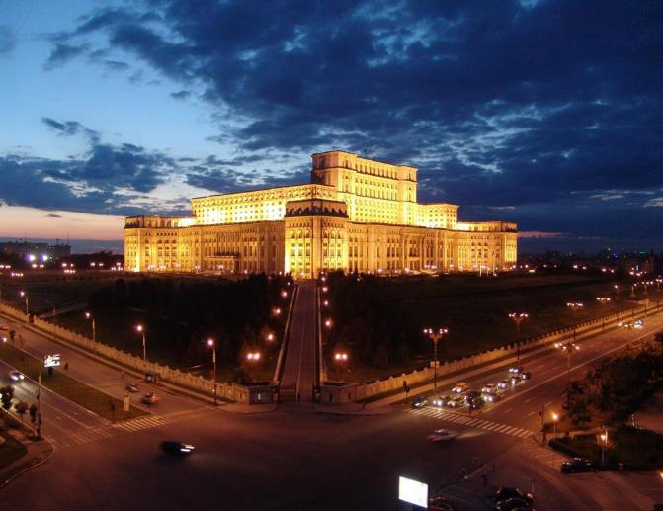
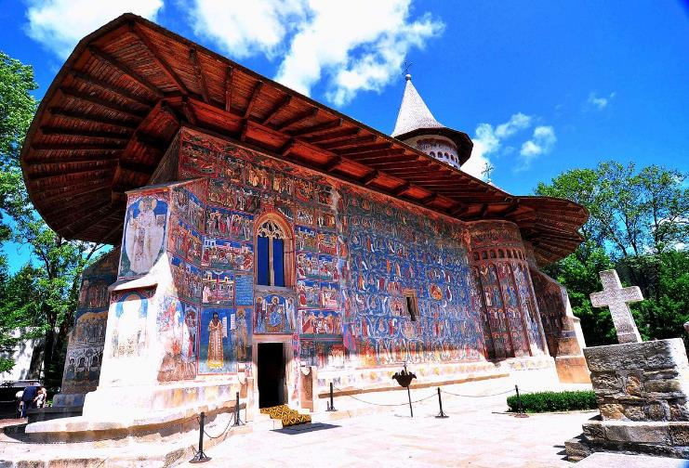
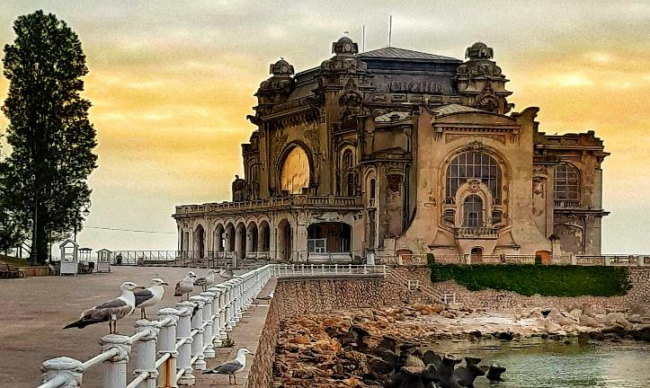
Architectural Masterpieces in Romania
“Voronet Monastery” , famous for the unique shade of blue in which it is painted,voronet blue
According to World Records Academy, “the Palace of Parliament” is the second largest administrative building for civilian use in the world, the most expensive administrative building in the world, and the heaviest building in the world. Vertically, there are three registers, which also correspond to distinct functional areas. The building has about 1000 rooms, of which 440 offices, over 30 halls and lounges, four restaurants, three libraries, two underground parking lots, a concert hall.
“The Casino in Constanta” , a buliding that transpusesus back into La belle epoque…

Slide 14
"This project has been funded with support from the European Commission. This publication reflects the views only of the author, and the Commission cannot be held responsible for any use which may be made of the information contained therein."
Erasmus+ ka229 project

