Slide 1
“Dwa Ognie”
“DODGEBALL”

Slide 2
Basic Rules:
Two teams compete in the game
There may be from 3 to even 20 players in each team
You can’t send off mother’s
You can’t step out pitch
You can’t cross the middle line

Slide 3
There is one ball thru all game time
If someone catch a ball, then the person that catched a ball throws it
Make a catch, then player that’s been hit comes back in from the jail
When someone hits you and u didn’t catched an ball you’re out

Slide 4
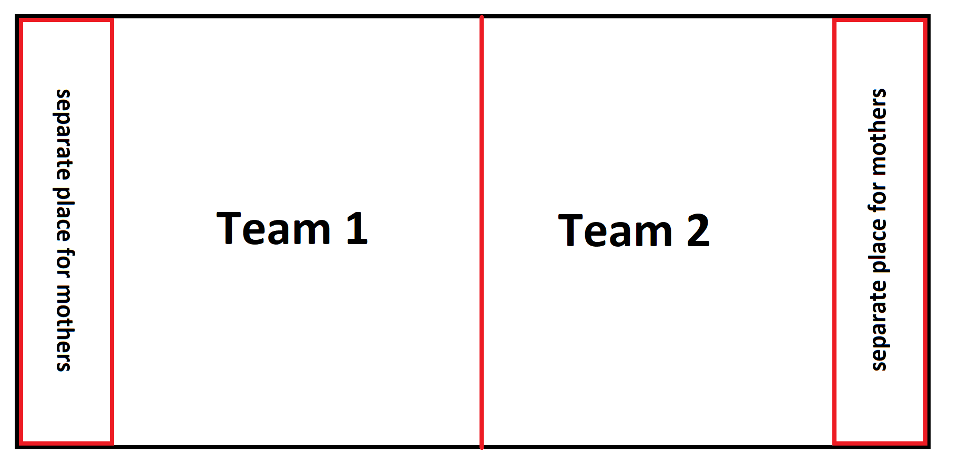

Slide 5
HAVE FUN!

